Slide 1

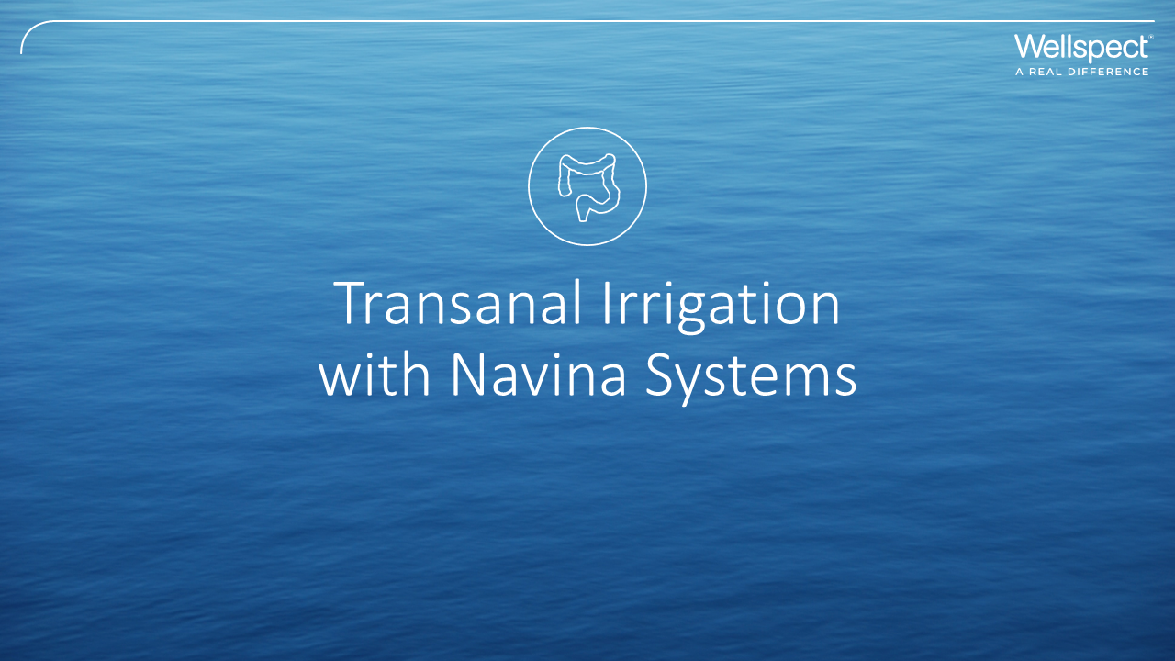
Notes:
This information do not replace the IFU, please read the IFU closely before you train a patient in the use of Navina.

Slide 2
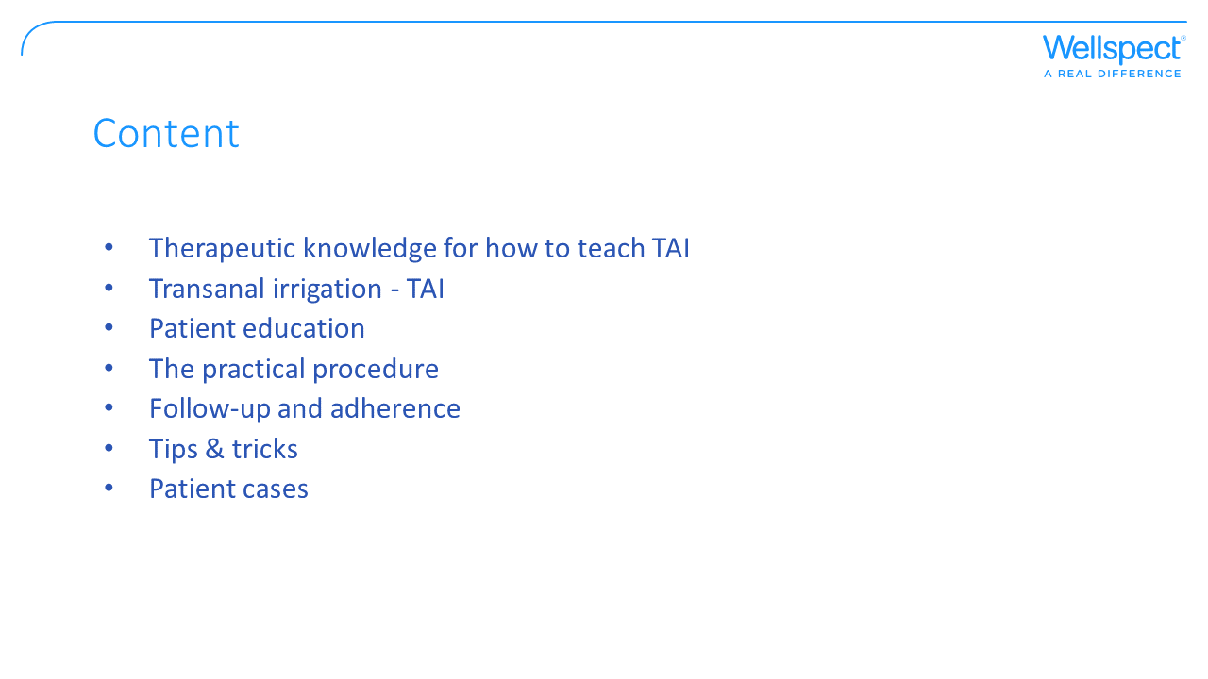
Notes:
This presentation intends to give you an overview of what you need to know about TAI and Navina Systems. It does not replace any guidelines or instructions that you have at your institution or instruct on how to assess patients. The information has been reviewed by nurses in clinical practice.

Slide 3

Notes:
This is a summary of the knowledge you need to have to teach TAI. In the following slides, you will find this information and in the end you will find cases describing patients and their way to TAI.

Slide 4
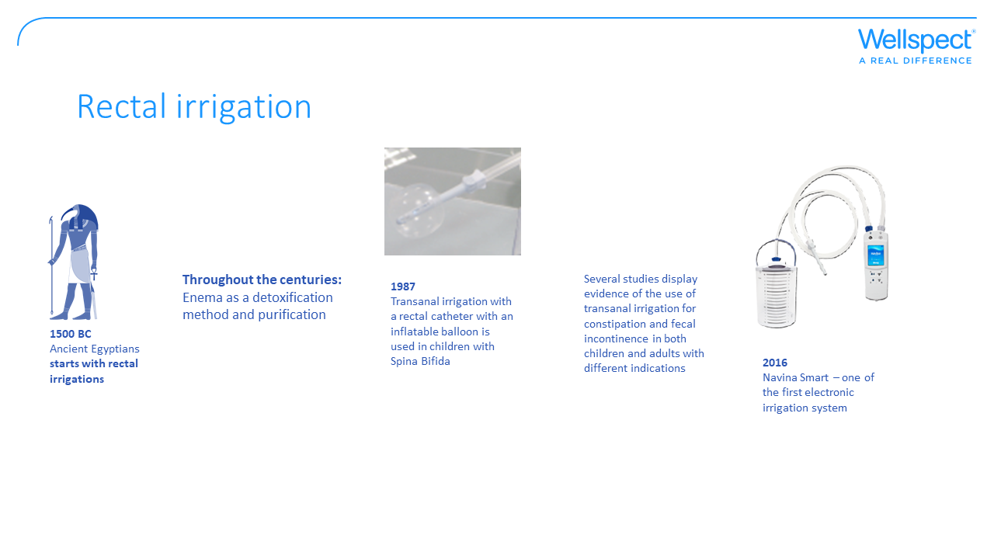
Notes:
Transanal irrigation (TAI) with medical devices may be a relatively new intervention for bowel dysfunction, but rectal/anal irrigation is an old concept. An Egyptian papyrus from the 16th century B.C. shows that it was believed that toxic substances produced by poorly digested foods could pass through the intestinal lumen and into the blood stream causing disorders even in distant organs. The use of rectal irrigation in the ancient Egyptians is believed to have been inspired by the sacred ibis who used its long beak to insert water into its anus to wash out decaying material according to the Roman writer Pliny the Elder (AD23-79). The sacred ibis was associated with their god of wisdom, Thoth, who was said to have devised the use of enemas to relieve bowel problems.
In antiquity medicine enemas and rectolysis were used to ‘‘free’’ the body of the ‘‘humors’’ and ‘‘poisons’’ believed to originate in the intestine and to cause diseases in many other organs. In the early 1900s a British surgeon, Sir William Arbuthnot Lane, had a theory that when the contents of the large intestine stagnate, ‘‘toxic substances’’ were more easily absorbed and lead to chronic disorders. As a result, he performed extensive colectomies on patients with a wide range of disorders: from arthritis to hypertension and skin pathologies. At the same time, the British Medical Journal published an article supporting this theory that fecal stasis altered colon bacterial flora, thus favoring bacteria capable of toxin production (either anaerobes or coliforms) with systemic effects.
To conclude, over the centuries TAI has been used to treat a long list of symptoms, including nausea, fatigue, depression, headache, anxiety, rheumatism and constipation. It has also been used as a ritual and part of the modern social phenomenon of colonic irrigation.
In the 1980’s, a special catheter with an inflatable balloon was devised to facilitate administration of the enema and that prevent leakage of the enema fluid for children with bowel dysfunction due to spina bifida (Shandling and Gilmour 1987). Since then, several studies have documented the efficacy and safety of the treatment in children. TAI has also been used in selected adults with constipation or fecal incontinence. In spinal cord-injured patients that benefits from the treatment, TAI could be difficult to manage due to immobility or impaired hand function (Christensen et al 2006).
In 2016 the first handheld electronical system for TAI, Navina Smart, was introduced at the market. With Navina Smart TAI is performed by pushing a button instead of manual pumping.

Slide 5


Slide 6
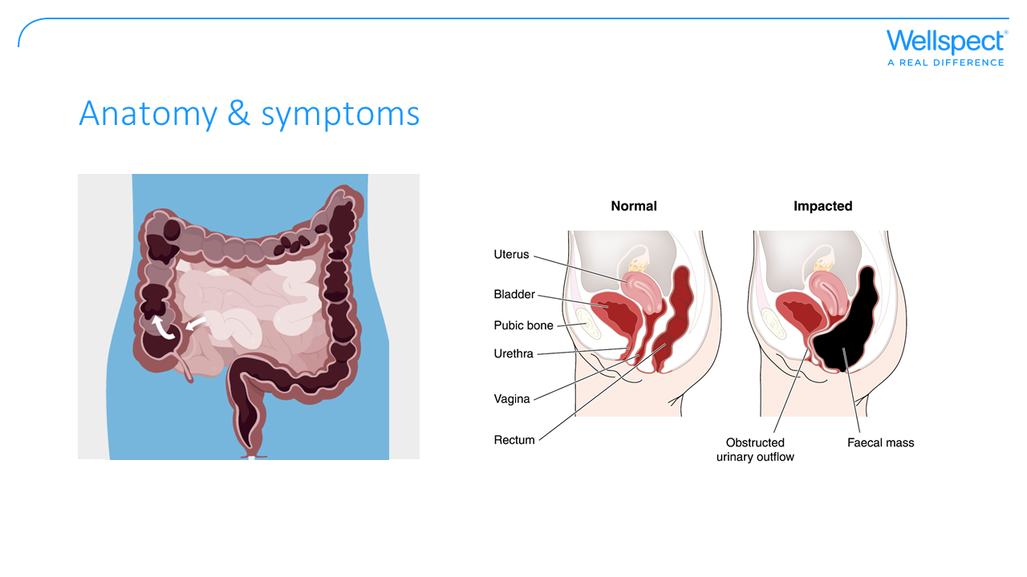
Notes:
The large bowel is the last part of the gastro-intestinal (GI) tract consisting of:
Colon – that extracts water and salts from the content. There are different parts of the colon; at the right side of the abdomen is the ascending colon, across to the left side is the transverse colon, and down the left side is the descending colon that join to the rectum.
Rectum – that function as a temporary storage site for feces. When the rectum is continuously filled with feces, the rectal walls will expand and send signals to the brain of a desire to pass feces. Rectum ends at the anorectal angle that needs to be straightened for release of feces. The angle is changed with body position and is almost reduced when squatting.
Anal canal - Is the final part of the large bowel and it has two surrounding muscle sphincters; the Internal Anal Sphincter (IAS) which consists of smooth muscle fibers that cannot be voluntary controlled and its relaxation during defecation depends by an intraparietal reflex. The External Anal Sphincter (EAS) consists of striated muscle fibers and can be voluntary controlled that needs to be relaxed during defecation to able the release of feces from rectum.
Symptoms of bowel dysfunction:
Constipation
Infrequent and irregular bowel movements
Can cause the bowel to stretch and the muscle to weaken over time or cause nerve damage leading to fecal incontinence
Fecal incontinence (FI)
Involuntary release of feces

Slide 7
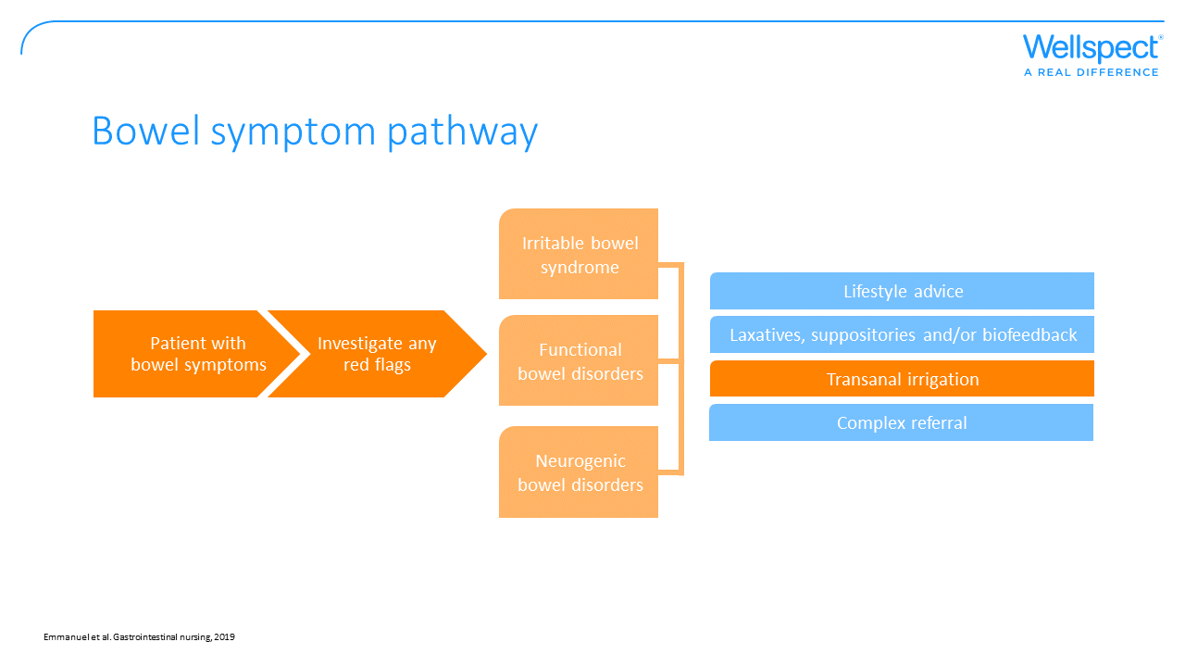
Notes:
Bowel management is similar in patients no matter the cause of the bowel issues. The difference may be that patients with neurogenic bowel disorders (NBD) may find the progress through the pathway quicker.
Red flags that need to be further evaluated:
Blood in feces
Weight loss
Abdominal pain
Recent and persistent changes in bowel habits
Family history of colorectal cancer or inflammatory bowel disease

Slide 8
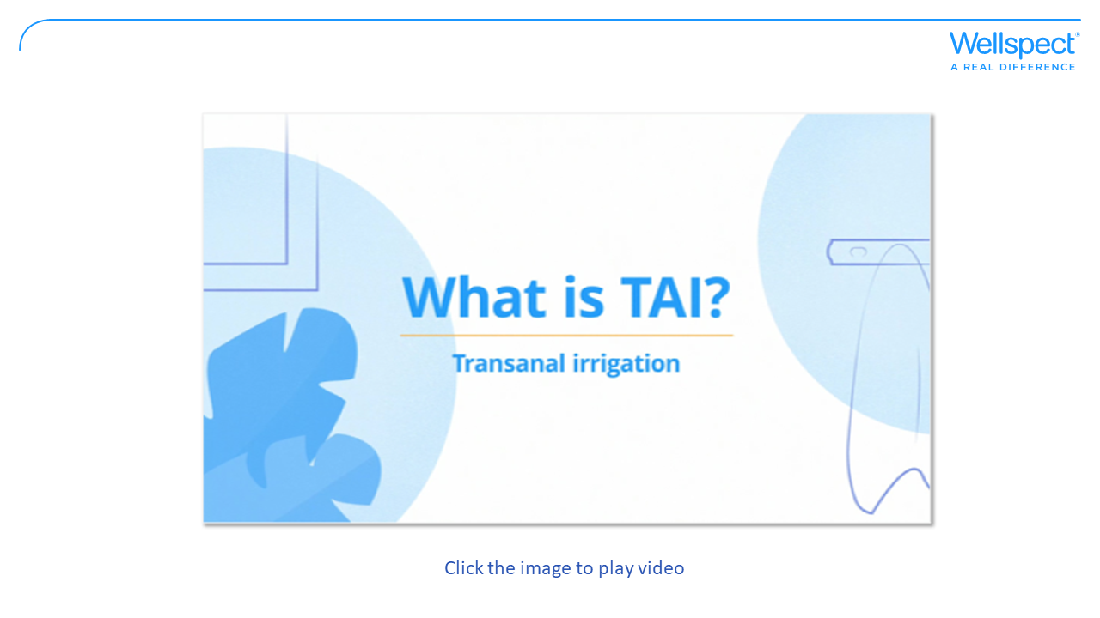
Notes:
Transanal irrigation (TAI) prevents constipation and fecal incontinence by effectively emptying the bowel by instilling luke-warm water into the colon, via a rectal catheter or cone. This will stimulate the body’s peristaltic movement to evacuate feces from the descending colon and rectum as well as the introduced water may soften the feces.
High volume TAI is when more than 250 mls of water are used and low volume TAI is when less than 250 mls of water is used. The volume of water affect how much of the bowel is emptied. With high volume TAI rectum and descending colon is emptied while with low volume TAI only the rectum is emptied.

Slide 9
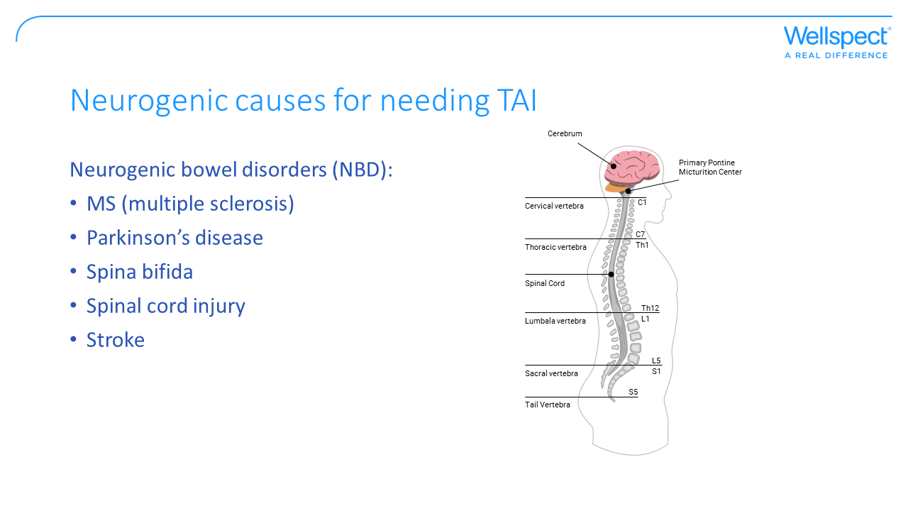
Notes:
The spinal cord and the brain play an important role for bowel problems in neurogenic diseases. When the nerves are damaged, it becomes harder for the signals between the brain and the part of the spinal cord controlling the bowel to reach their destination. There are several studies displaying the benefit of use of TAI in patients with NBD (Christensen & Krogh. Scand. J. Gastroenter. 2010).

Slide 10
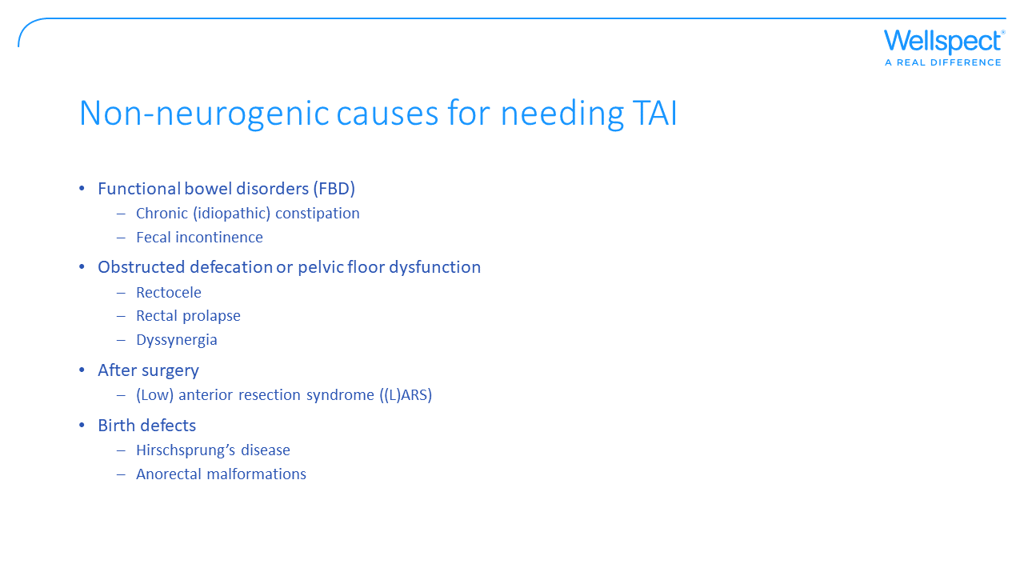
Notes:
There are several non-neurogenic indications that could benefit from the use of TAI. For example, there are several studies that shows a positive response to TAI in patients suffering from FBD (Emmett et al. BMC Gastroenterology 2015) and LARS patients treated with TAI achieved a clinically relevant improvement in chronic major LARS (Enriquez-Navascues et al. Colorectal Disease, 2019).

Slide 11
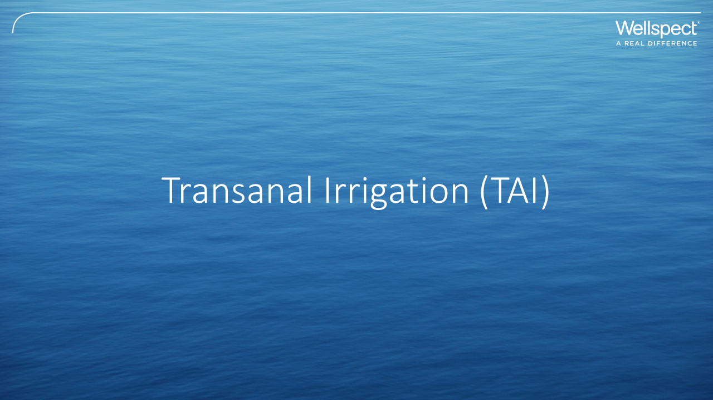

Slide 12
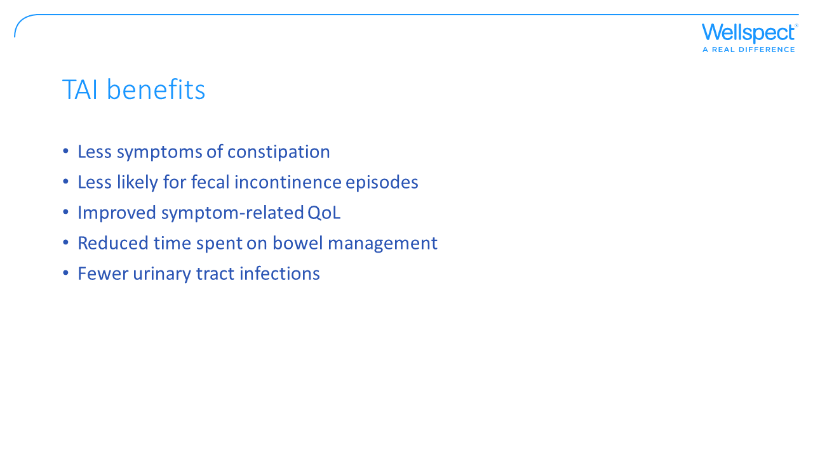
Notes:
Compared to first line treatment, patients using TAI had (Christensen et al 2006, Christensen et al 2008, Del Popolo et al 2008, Emmanuel et al 2016, Etherson et al 2017):
Less symptoms of constipation
Less likely for fecal incontinence episodes
Improved symptom-related QoL
Reduced time spent on bowel-management procedures
Lower rates of urinary tract infections
Lower rates of stoma surgery

Slide 13
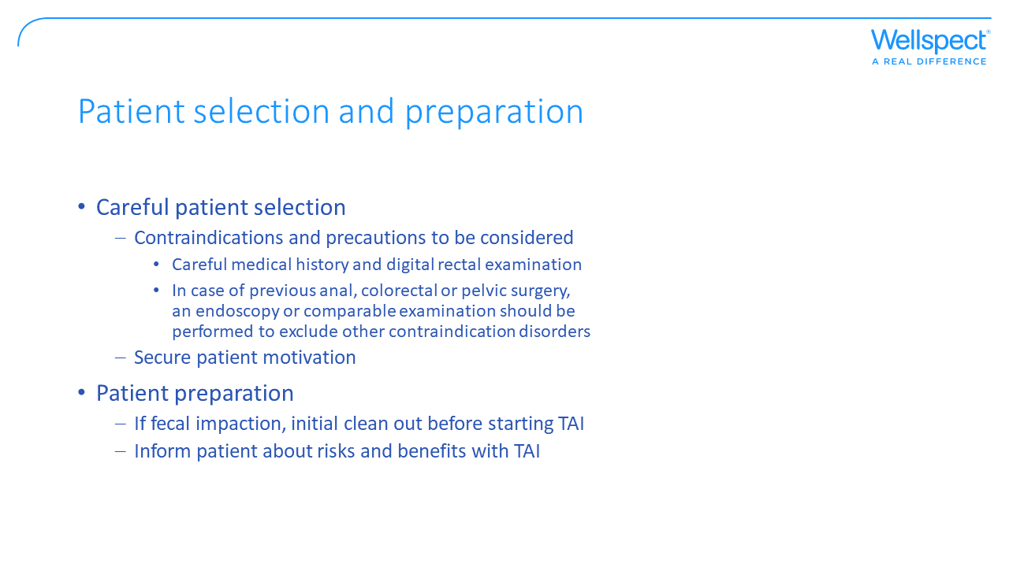
Notes:
Patient selection and preparation are important to receive a successful outcome of TAI.
Contraindications for transanal irrigation, i.e. do not use Navina Systems if the person has one or more of the following:
• Known anal or colorectal stenosis
• Active inflammatory bowel disease
• Acute diverticulitis
• Colorectal cancer
• Ischemic colitis
• You are within three months of anal or colorectal surgery
• You are within 4 weeks of previous endoscopic polypectomy

Slide 14
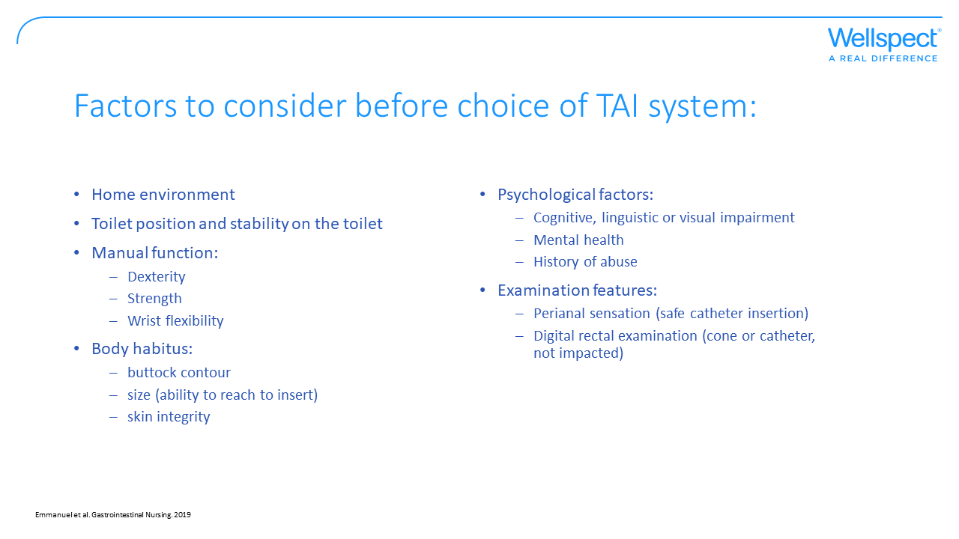
Notes:
There are several factors that could influence the use of TAI and to be considered before starting with TAI to make sure that the right device is selected and ease the irrigation procedure.
In the home environment
how is the access to toilet or commode chair, is there room enough, will it be possible to fill the water container, hang it or could it stand.
Consider if noise could be an issue for dignity and privacy factors.
If depending on carer, how is the toilet access and transfers possible.
Toilet position and stability on the toilet:
Teach to brace, sit forward, knees raised. Is the patient able to be instructed? Need of aids?
If seated upright, is the patient stable enough for use of a catheter?
If leaning, is the patient stable enough for use of cone?
Manual function:
Is the patient's dexterity, hand strength and wrist flexibility making them able to insert the catheter/cone, hold a cone in place, use a manual pump device?
Body habitus
The patient’s buttock contour and size may affect the ability to hold on to a cone or to reach to insert catheter/cone.
The skin integrity could be checked for assessment of incontinence, sensation, friction and/or shearing.
Psychological factors:
Is the patient able to understand and read instructions?
If the patient has a history of abuse he/she may require additional counselling.
Examination features:
Digital rectal examination is important to perform to assess the anal tone, if anal tone is poor a rectal catheter is preferred (not cone), and to make sure the insertion is safe. If poor sensation it is important with instructions of how to safely insert the catheter.
Also to exclude fecal impaction. If fecally impacted, the impaction needs to be treated before start of TAI.

Slide 15
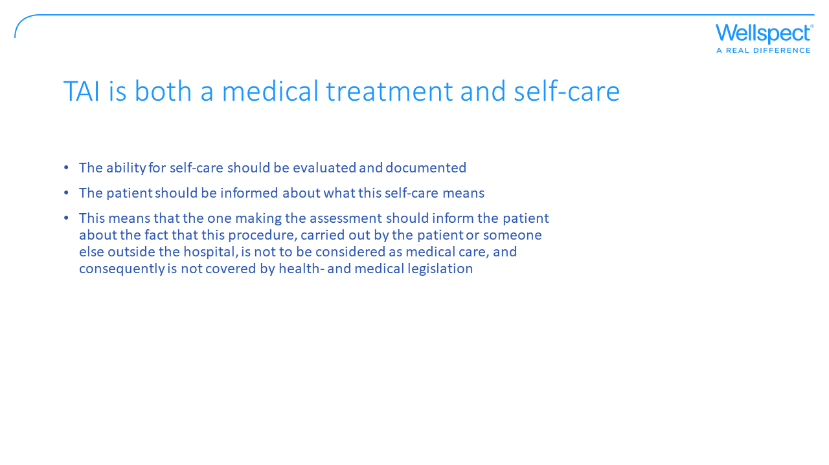
Notes:
The healthcare should document the assessment and analysis of self-care in the patient journal. It’s important that the one making the assessment gives an account for his/her position. The extent of the documentation varies from case to case and the complexity of the evaluation. A patient’s medical record should contain the information needed for good and safe care of the patient and the necessary information regarding measures taken.
Obtaining informed consent is essential before carrying out treatment. It is important for all patients to achieve self-determination and autonomy, your organization may have a policy setting out when you need to obtain written consent, but always record the type of consent obtained in the patient’s medical records.

Slide 16
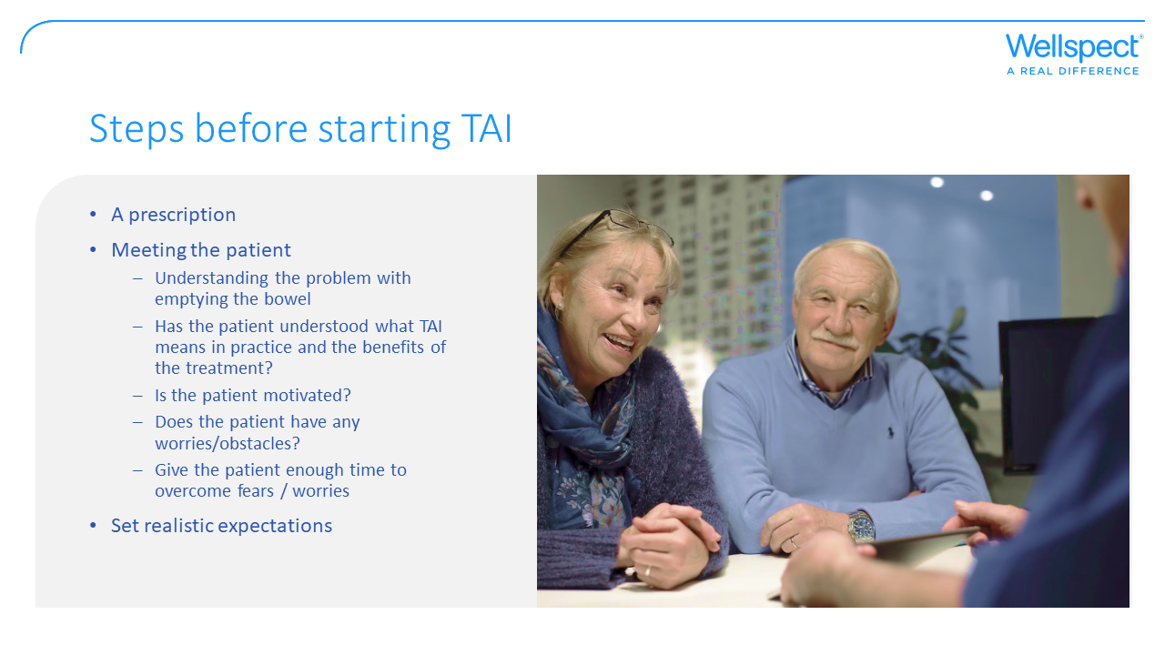
Notes:
Motivation and patience is essential.
Be prepared and give yourself time to change habits, both mentally and physically, and the bowel to adapt to your new routines. You also need time to find your optimal treating parameters.
It is important to have realistic expectations of what TAI can do for you and how long it may take to achieve satisfactory results. A commitment of up to 4–12 weeks is necessary in order to stabilize the bowel and to develop a good individualized defecation routine.
Give it time. It is worth it!

Slide 17


Slide 18
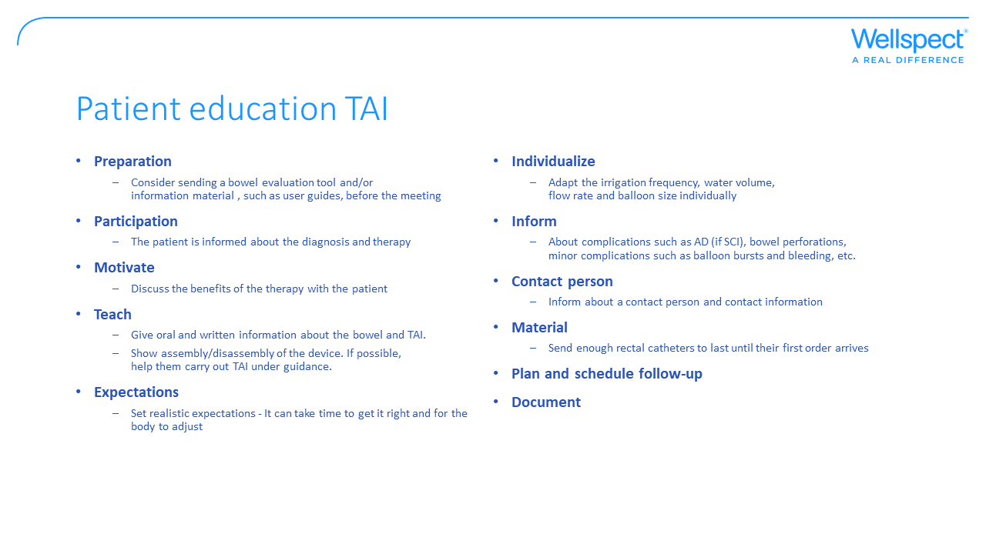
Notes:
It is pivotal that the patient is given a good knowledge of the anatomy and physiology of the bowel as well as a good understanding of the benefit of their treatment. Using pictures and illustrations to visualize often helps. A user guide can be a good way for the patient to learn more about the therapy before or after the visit.
Make sure that the patients have realistic expectations, TAI is not a quick fix. It can take up to 12 weeks to get an efficient therapy with right settings. It is good to have a monitoring tool to measure outcome of therapy such as a bowel diary or score to evaluate improvement or not.
Complications and countermeasures will be described in following slides, brief:
Inform the patient of the symptoms of bowel perforation, it is a rare complication, but important to know the symptoms to not be left untreated. If at risk of autonomic dysreflexia (AD), inform about the symptoms of AD and what action to take in case of symptoms.
Balloon burst do not usually cause any harm, but maybe unpleasant for the patient.
Minor bleedings could occur, but if persisting or copious medical care is needed.
Please do a careful walkthrough with the patient about how to handle the TAI system. In order to ensure good compliance over time, a structured and pedagogical education and follow-up of the therapy is required. Plan for the first visit to last for about 60 mins.

Slide 19
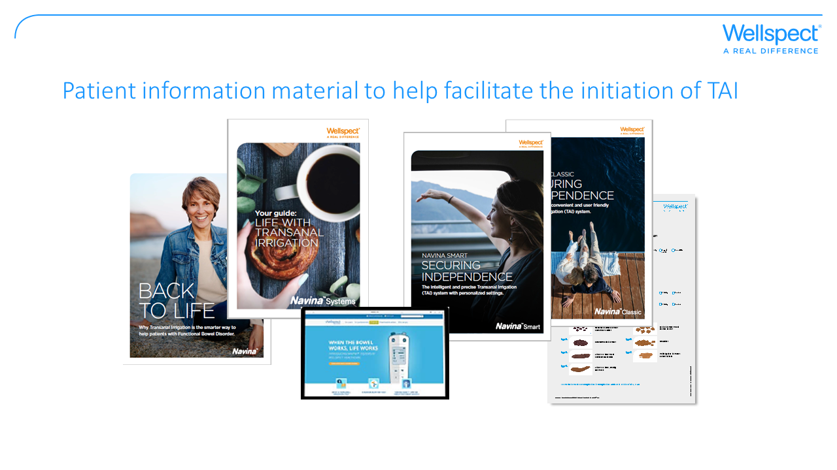
Notes:
Just as the studies show, it’s very important to give the patients good information before they begin using TAI, and it’s also important with a good follow-up.
Wellspect offers a wide assortment of information material in order to help the patient to a good start.
At wellspect.com you’ll find material and information such as:
Product information
User guides
Instruction films
Testimonials and much more…

Slide 20
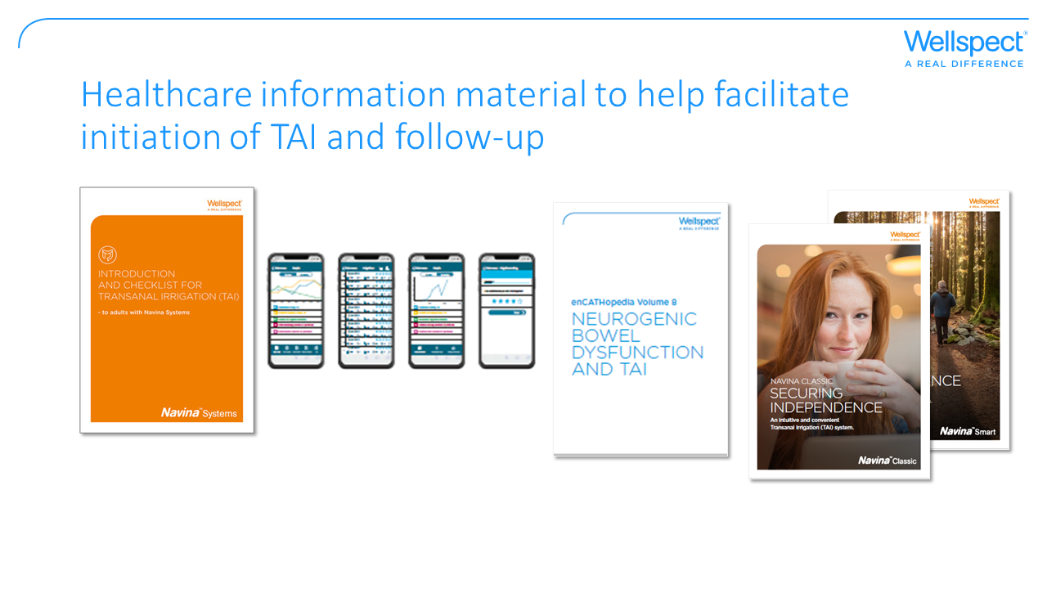
Notes:
There is material helping you when initiating TAI such as:
Checklist: As support when initiating TAI.
Navina Smart app: For users of Navina Smart, Navina Smart app is an automatic irrigation diary which can be used in the follow up discussions to tailoring the settings to fit individual needs.
Folders and information: About products and different indications.
This material may be ordered through Wellspect – either through your sales representative or through our website.

Slide 21
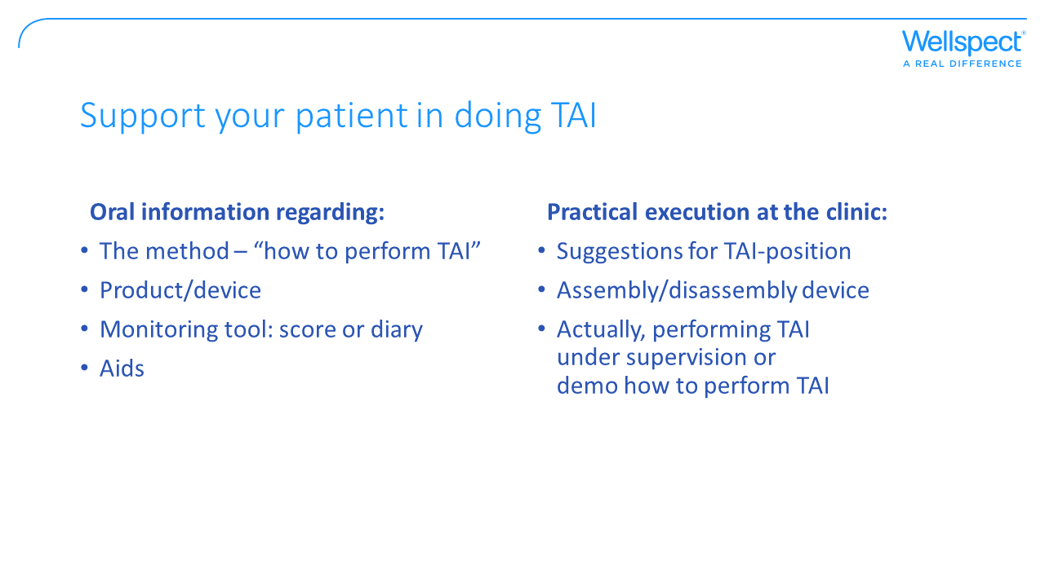

Slide 22
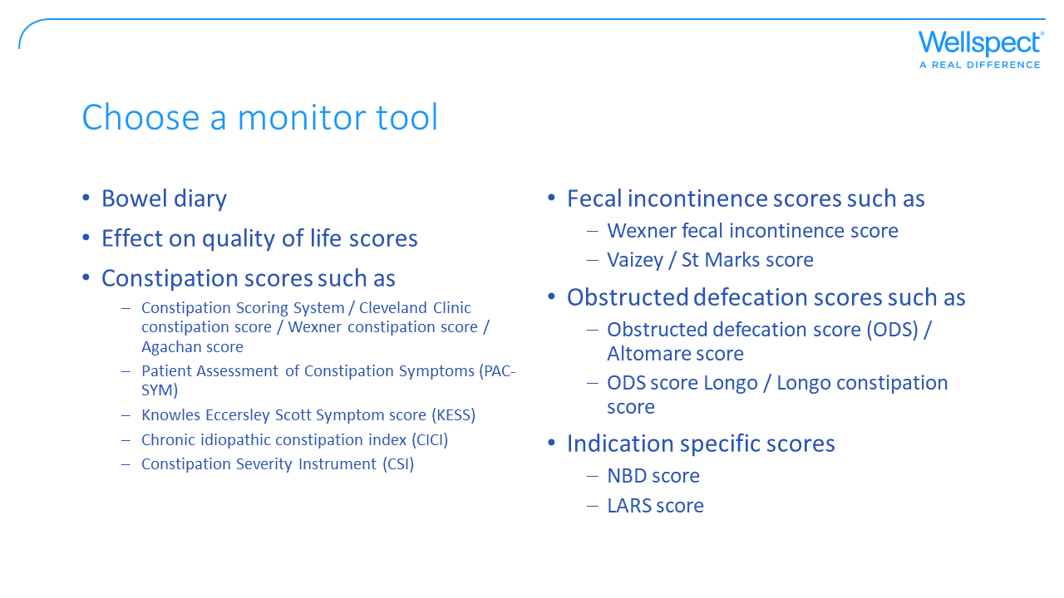
Notes:
It is important to have a monitoring tool to recognize not only when there has been an adequate response to the treatment, but also when the treatment needs to be escalated.
There are several different monitoring tools available that may suit different individuals depending on their most bothersome symptoms (more information about different scores is found in Explore “How to evaluate bowel dysfunction”).

Slide 23
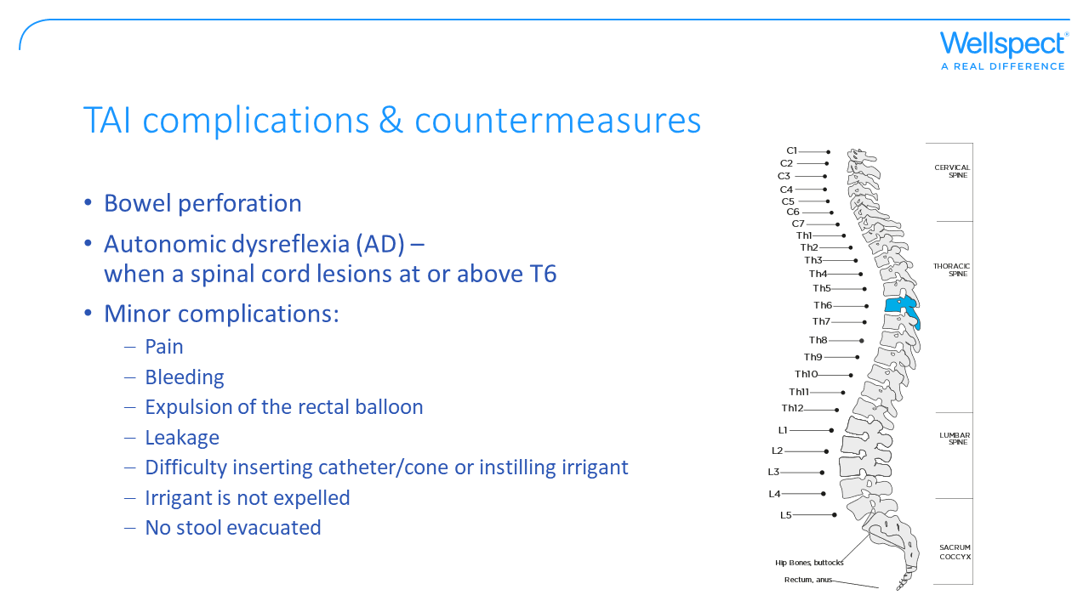
Notes:
Complications with TAI that requires medical care are bowel perforation and autonomic dysreflexia (if severe). There are other, minor, complications that causes poor treatment adherence such as soiling between TAI periods, leakage of irrigation fluid, repeated expulsions of the catheter and rectal balloon bursts.
Minor pain is experienced by many users of TAI and may be due to the discomforts of the procedure while severe pain need to be investigated to exclude a bowel perforation.

Slide 24
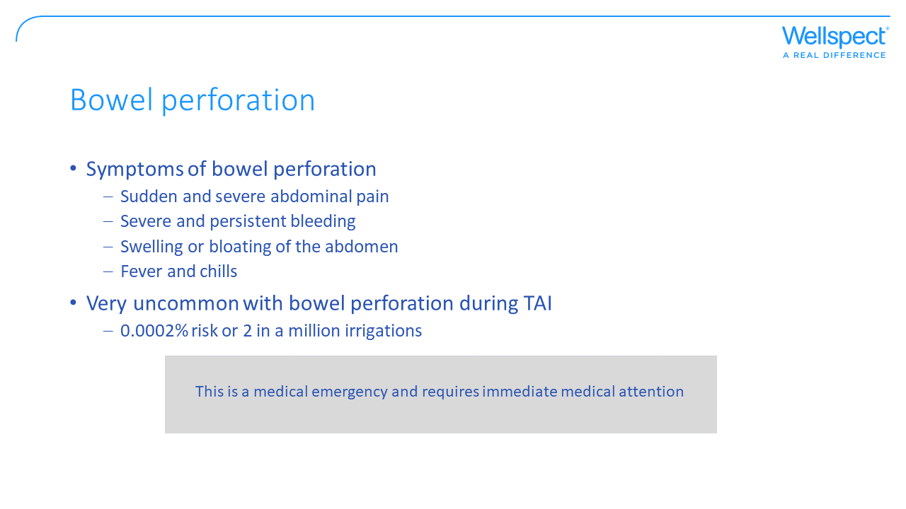
Notes:
One of the most serious events that can occur with TAI is a bowel perforation. If a sign or symptom of bowel perforation is presented the user should immediately contact the healthcare. The severity of a bowel perforation varies from minor symptoms that can be treated with antibiotics to severe symptoms that need surgery. If left untreated, there is a risk of death.
In a global audit on bowel perforations during TAI the occurrence rate was shown to be 2 cases out of a million irrigations (0.0002% risk), with an increased risk during treatment initiation and in patients with prior pelvic organ surgery and from rectal balloon burst (Christensen et al 2016).

Slide 25
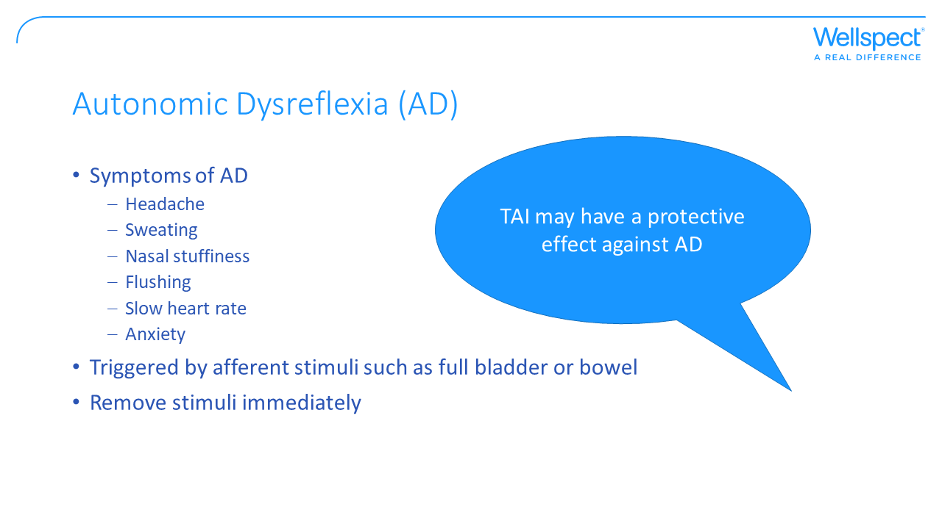
Notes:
Autonomic Dysreflexia (AD) is a potentially life-threatening acute condition requiring immediate emergency care and the condition most typically occurs in the SCI population, especially those with a lesion at or above the T6 spinal cord level. Acute AD is a reaction of the autonomic nervous system to overstimulation and is characterized by paroxysmal hypertension with headache, profuse sweating, nasal stuffiness, flushing of the skin above the level of the lesion, slow heart rate, anxiety, and sometimes by cognitive impairment (Khastgir et al 2007). AD is believed to be triggered by afferent stimuli (nerve signals that send messages back to the spinal cord and brain) which originate below the level of the spinal cord lesion from example the bowel or bladder. If AD occurs the recommendation is to remove the stimuli immediately. For autonomic symptoms (sweating, palpitations and dizziness) occurring during TAI it is recommended to slow down instillation of irrigation fluid, limit the time on the toilet and to have medications for AD available.
In addition; in a randomized controlled study investigating TAI, the symptoms related to AD tended to be more common in the non-TAI group, potentially suggesting that TAI may have a protective effect against AD (Christensen and Krogh, 2010).

Slide 26
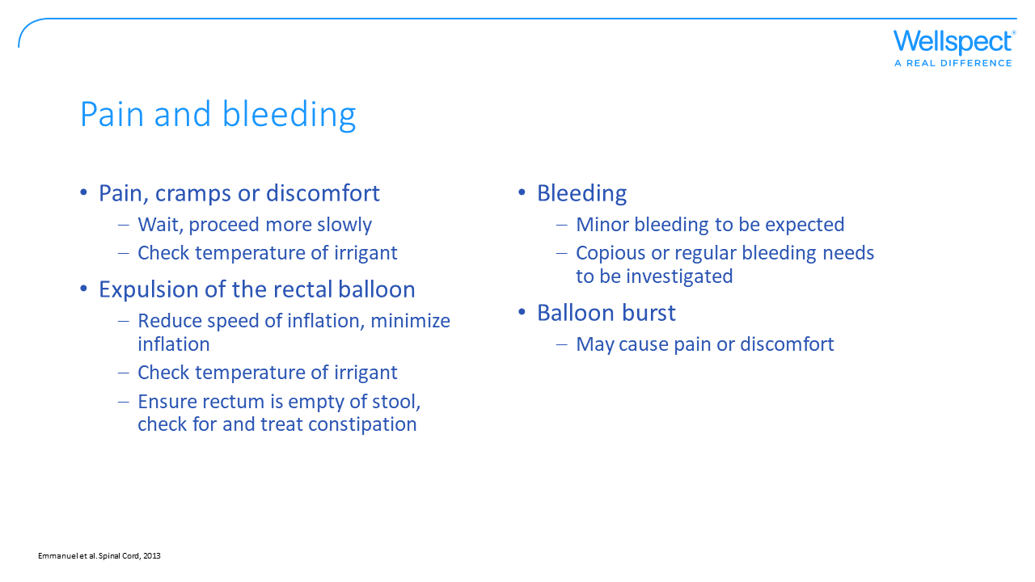
Notes:
Pain –If cramps, discomfort or pain occur during instillation of water, pause instillation for a moment and continue more slowly, ensure the irrigant has the right temperature (36-38 degrees Celsius). If pain is severe and/or persist stop irrigating, could be a bowel perforation, seek medical care.
Expulsion of the rectal catheter balloon - Inflate the rectal balloon more slowly and minimise the size of the balloon to avoid triggering reflexes, check the water temperature (36-38 degrees Celsius), ensure rectum is empty of stool and check that there is no impaction/constipation.
Bleeding – a small amount of bleeding can be expected, but if regular or copious bleeding occurs it need further investigation. Haemorrhage with or without pain could be a bowel perforation and should be treated as a medical emergency.
Balloon bursts – excessive inflation may cause the balloon to burst, which may cause an anorectal trauma. The risk of trauma is low, but a balloon burst can cause discomfort and pain. Only inflate the rectal balloon as much as considered necessary to prevent leakage during instillation of irrigant.

Slide 27
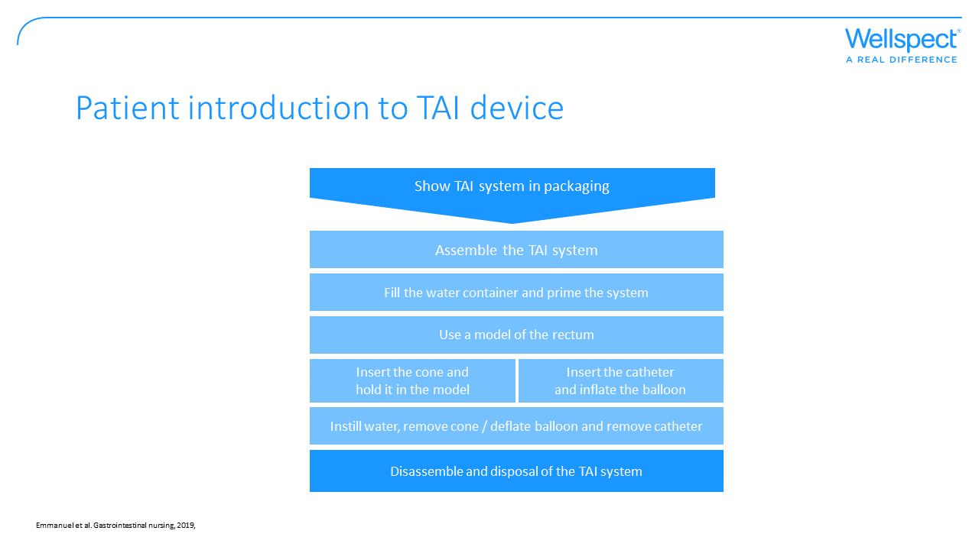

Slide 28
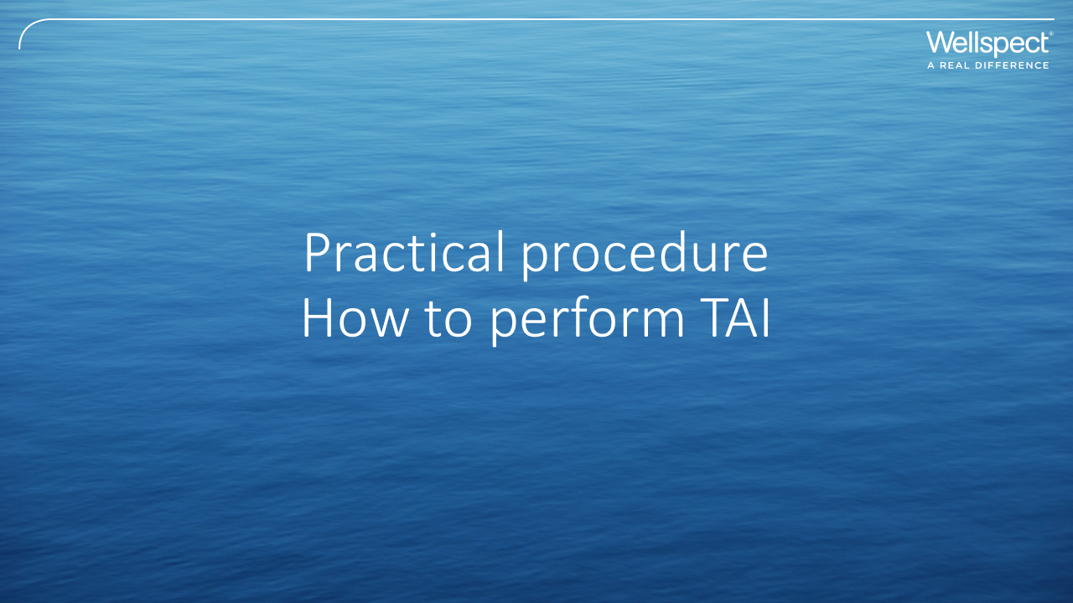

Slide 29
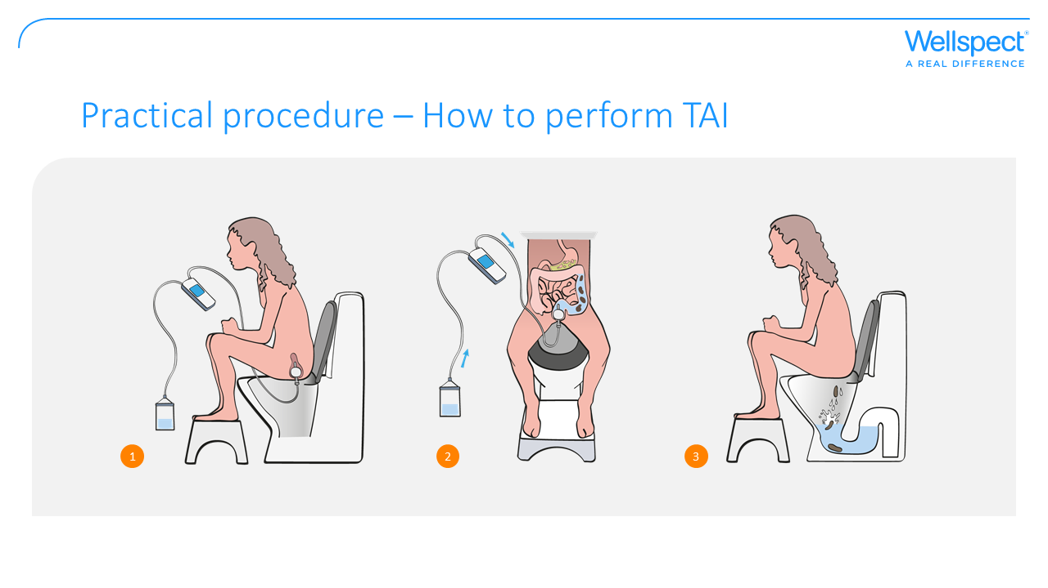

Slide 30
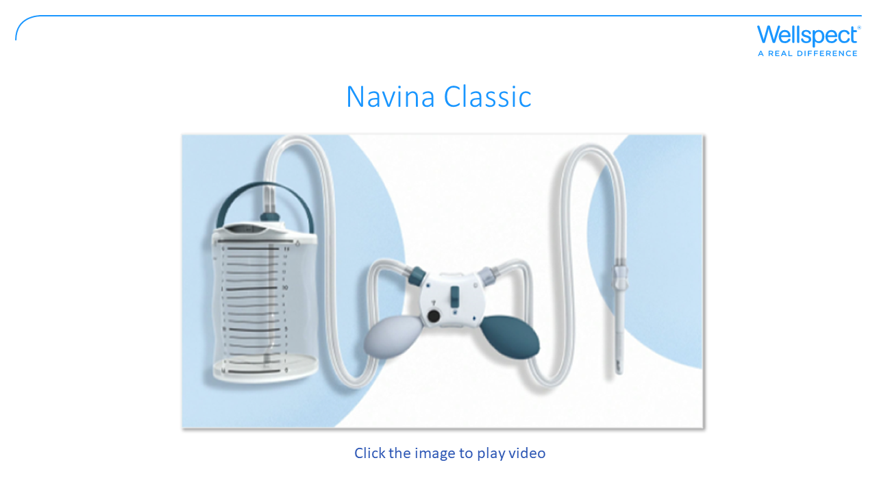
Notes:
Intended Use
The Navina Systems is intended for Transanal Irrigation by instilling water up into the lower part of the
colon through a rectal catheter.
Indications
The Navina Systems is indicated to help adults and children from 3 years who suffer from faecal
incontinence, chronic constipation, and/or time consuming bowel management.
By instilling water up into the lower part of the colon, the peristaltic muscles in the bowel can be triggered
and start to evacuate the content of the lower colon and rectum.

Slide 31
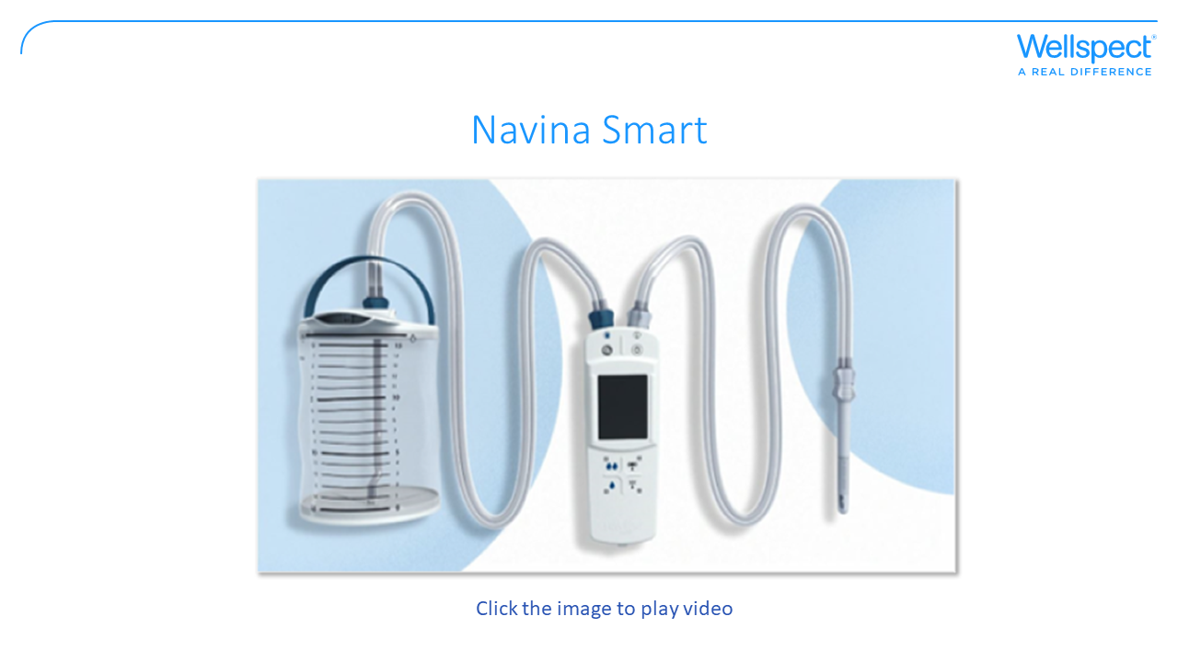
Notes:
Intended Use
The Navina Systems is intended for Transanal Irrigation by instilling water up into the lower part of the
colon through a rectal catheter.
Indications
The Navina Systems is indicated to help adults and children from 3 years who suffer from faecal
incontinence, chronic constipation, and/or time consuming bowel management.
By instilling water up into the lower part of the colon, the peristaltic muscles in the bowel can be triggered
and start to evacuate the content of the lower colon and rectum.

Slide 32
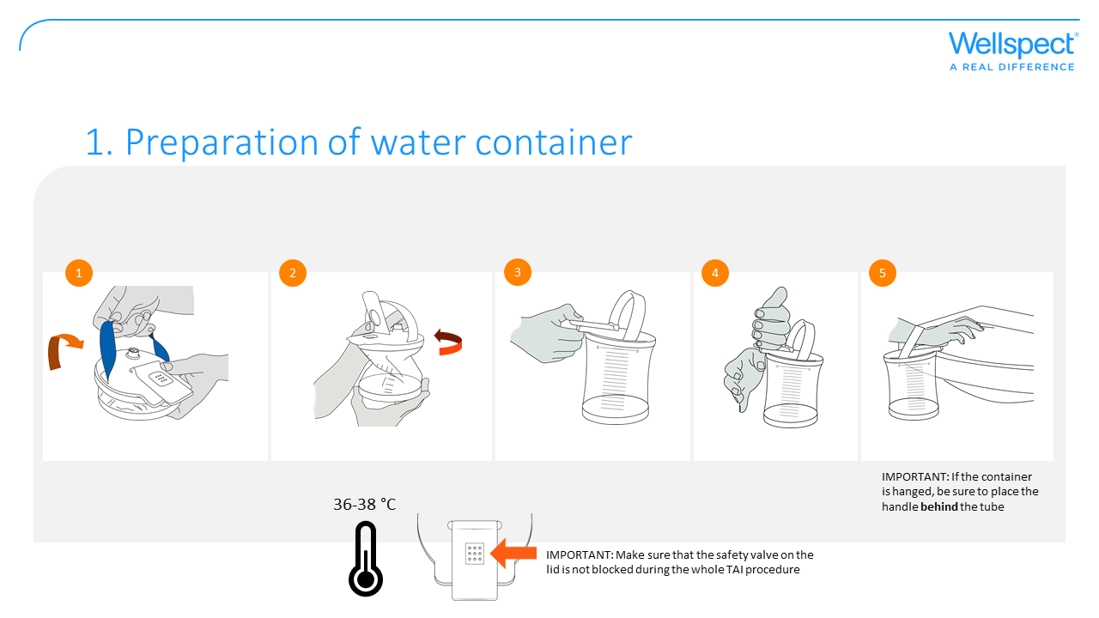
Notes:
Prepare the water container and fill it with lukewarm water (36-38 degrees Celsius).
1. Open the lid of the water container.
2. Unwrap the water container by releasing the handle and expanding the container.
3. Children: Fill the container with lukewarm clean tap or bottled water to the level given by your healthcare professional + max 200 ml for activating the cone’s slippery surface.
Adults: Fill the container with lukewarm clean tap or bottled water to the upper mark of the container.
4. Gently close the lid of the container until it clicks. Different ways of doing this are
illustrated below.
5. Place the container wherever is most convenient during the TAI procedure; standing on
the floor, hanging by the handle or placed on a shelf or in the sink.

Slide 33
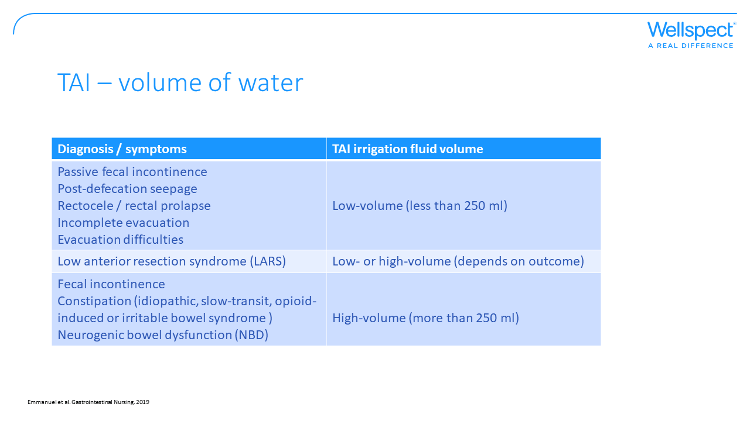
Notes:
Depending on the symptoms of the patient different volumes of irrigation fluid may be needed. High-volume TAI is often referred to as more than 250 mls while low-volume TAI is considered to be up to 250 mls. The volume of water instilled affects the emptying, high-volume will empty a large part of the colon while a lower volume may empty only rectum (Emmanuel et al 2019).
Children:The lowest volume of irrigant should be used that achieves the desired effect. It is recommended to use a volume of irrigant of 10 to 20 mL/kg, with a maximum total volume of 1 L. This calculation should be based on ideal body weight for height rather than the actual weight of an obese child (Mosiello et al. JPGN, Volume 64, Number 3, 2017).

Slide 34
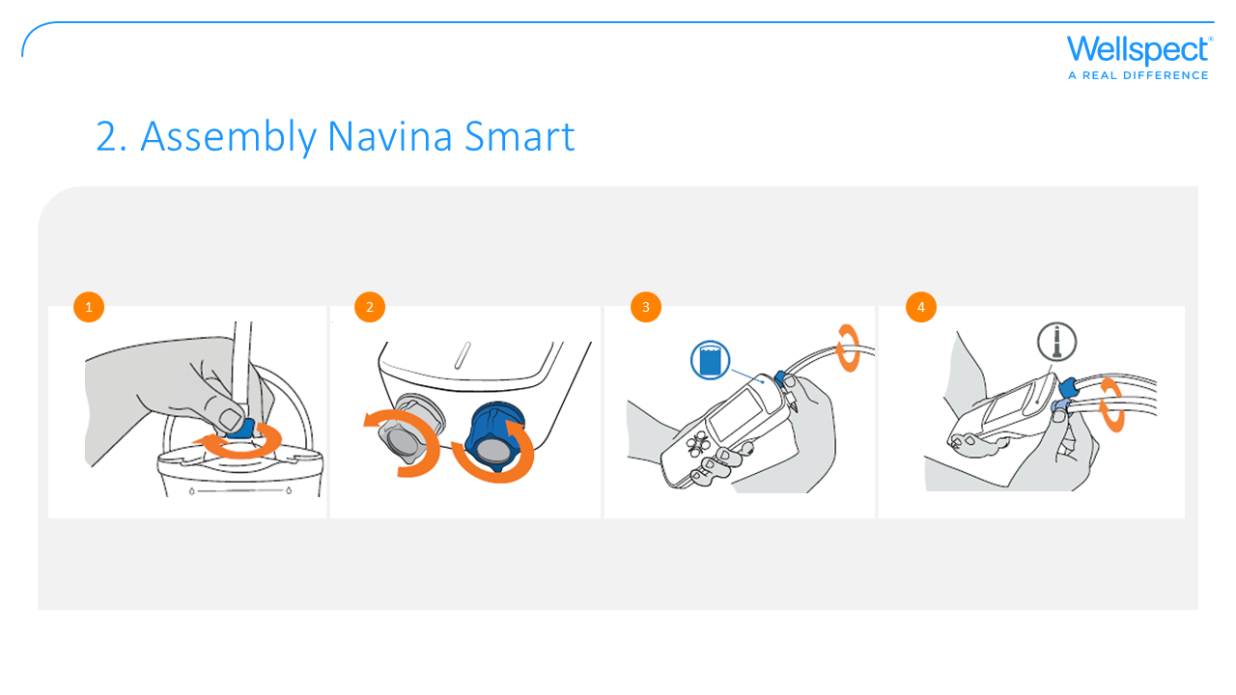
Notes:
Assembly the device according to color codes and make sure all connectors are in place and locked.
1. Connect the tube with dark blue connectors to the dark blue connector on the water container. Lock the connection by turning it clockwise until it stops.
1b. Remove the protective caps.
2. Connect the other end of the tube with dark blue connectors, to the dark blue connector with the water symbol on the Navina control unit. Lock the connection by turning it clockwise until it stops.
3. Connect the tube with the light blue connector to the light blue connection and the catheter symbol on the Navina control unit. Lock the connection by turning it clockwise until it stops.
4. Peel the cone/catheter packaging open 2-3 cm to expose the rectal cone/catheter connection. Do not remove the cone/catheter from the packaging.
5. Attach the tube with the white connection to the cone/catheter. The connection is half-moon shaped to help connect it correctly. Lock the connection by turning it clockwise until it stops.
6. Attach the packaging to a vertical surface by the adhesive patch, place it in the sink or in a tall glass to keep the incoming water remain in the package.
7. Ensure that the placement of the cone/catheter is within easy reach when seated on the toilet.

Slide 35
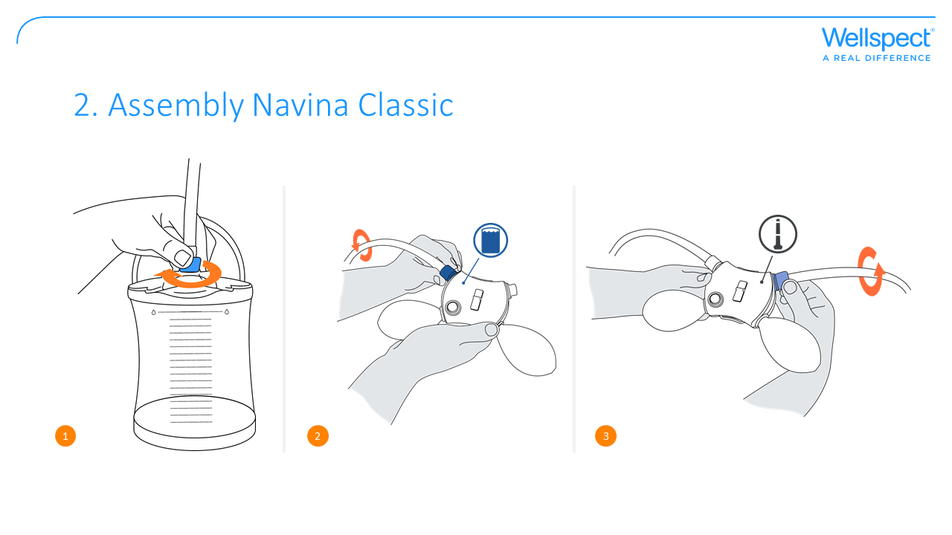
Notes:
Assembly the device according to color codes and make sure all connectors are in place and locked.
1. Connect the tube with dark blue connectors to the dark blue connector on the water container. Lock the connection by turning it clockwise until it stops.
2. Connect the other end of the tube with dark blue connectors, to the dark blue connector with the water symbol on the Navina control unit. Lock the connection by turning it clockwise until it stops.
3. Connect the tube with the light blue connector to the light blue connection and the catheter symbol on the Navina control unit. Lock the connection by turning it clockwise until it stops.
4. Peel the cone/catheter packaging open 2-3 cm to expose the rectal cone/catheter connection. Do not remove the cone/catheter from the packaging.
5. Attach the tube with the white connection to the cone/catheter. The connection is half-moon shaped to help connect it correctly. Lock the connection by turning it clockwise until it stops.
6. Attach the packaging to a vertical surface by the adhesive patch, place it in the sink or in a tall glass to keep the incoming water remain in the package.
7. Ensure that the placement of the cone/catheter is within easy reach when seated on the toilet.

Slide 36
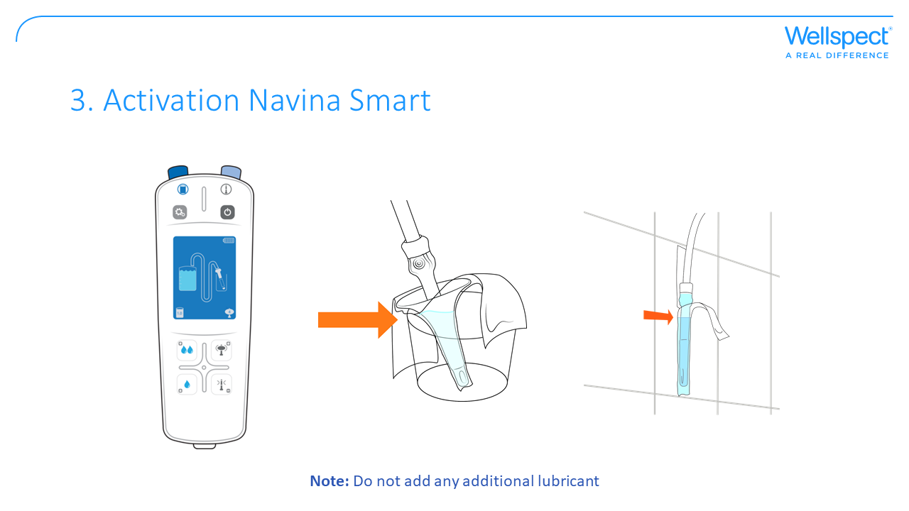
Notes:
The rectal cone/catheter has a hydrophilic surface to ease insertion and it is activated with water.
Navina Smart
1. Turn on the Navina Smart control unit by pressing the on/off button . A blue light will indicate that the device is on and the display will show the welcome screen.
2. Press “Deflation of balloon”- button to enter activation mode. The display will show the water container and the catheter pointing down in its packaging on a blue background.
3. Press and hold “instillation of water”-buttons 1 or 2 to start the water flow. This will empty the tubes of air and activate the hydrophilic surface on the catheter making it slippery.
4. Release the “instillation of water”-button when the water has reached ¾ of the catheter or most part of the cone.
5. Press “Deflation of balloon”- button to proceed to the instillation mode.

Slide 37
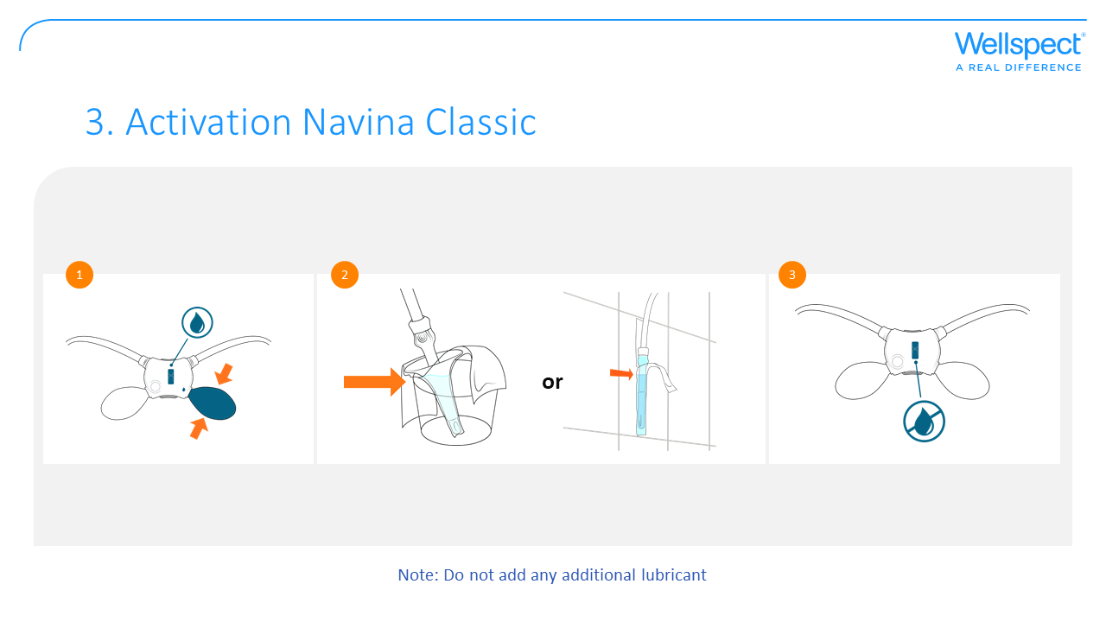
Notes:
The rectal cone/catheter has a hydrophilic surface to ease insertion and it is activated with water.
Navina Classic
1. Make sure the water flow is open. The water flow is open when you can see the water symbol above the blue switch.
2. Use the dark blue pump to start the water flow. This will empty the tubes of air and activate the hydrophilic surface on the cone/catheter making it slippery.
3. Close the water flow with the switch when the water has reached ¾ of the catheter or most part of the cone.

Slide 38
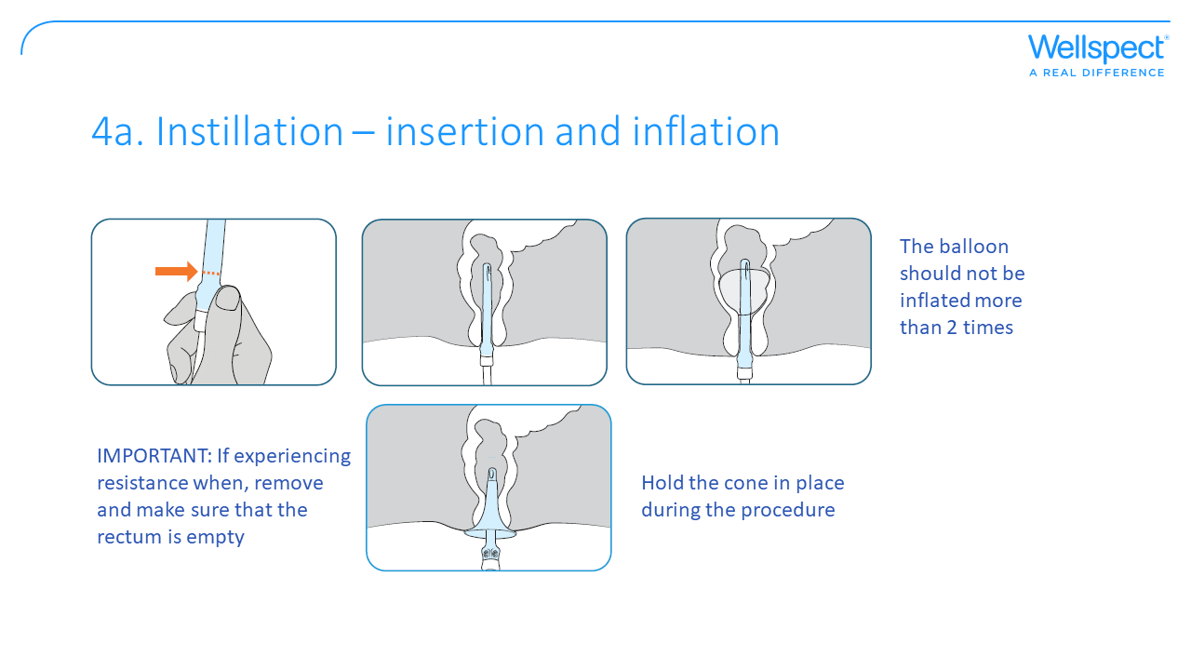
Notes:
Insertion of catheter or cone can be performed in a sitting, squatting or standing position; most people will sit to insert it. Children: Find the position that is best for the child, this can be bending over with knees bent or sitting on the toilet or crouching.
Insert the catheter or cone
1. Make sure not to block the flow in the tubes in any way, e.g. by sitting on them.
2. Remove the catheter or cone from its packaging. Keep the package for the disposal of the catheter or cone.
3. Hold at the catheter’s or cone’s handle.
4. Carefully insert the catheter/cone, without any force, into the rectum. Never insert catheter or cone with force and never insert beyond the cone’s widest part or the catheter’s maximum insertable length.
NOTE: Digital evacuation may be needed to ensure that the catheter/cone can be safely and correctly inserted. This is particularly important during the early use of the system. When well established, the rectum will usually be empty when conducting TAI. However, if resistance continues do not force the cone into the rectum. Stop using the irrigation and evaluate cause of resistance.
Inflate balloon
Children: Monitor the child’s face during inflation, for signs of distress or discomfort. Stop or pause if it is uncomfortable for the child.
Navina Smart
1. Press “inflation balloon”-button on the Navina Smart control unit to inflate the balloon. Stop the inflation at any time by releasing the button.
2. Inflate the balloon up to the set size that is preset. It is recommended to start with a small balloon and increase if needed.
3. Gently pull the catheter slightly down to seal off the rectum.
Navina Classic
1. Use the light blue pump on the Navina Classic control unit to inflate the balloon. Stop the inflation at any time
by releasing the pump.
2. Inflate the balloon up to recommended size. It is recommended to start with a small balloon and increase if needed. Never use more than 5 pumps when you are using the regular catheter and never use more than 2 pumps when you are using the small catheter.
3. Gently pull the catheter slightly down to seal off the rectum.
IMPORTANT: Do not over inflate the catheter balloon as this may cause the balloon to burst.
Note: If you need to adjust the catheter’s position, deflate the balloon completely and reposition the catheter.

Slide 39
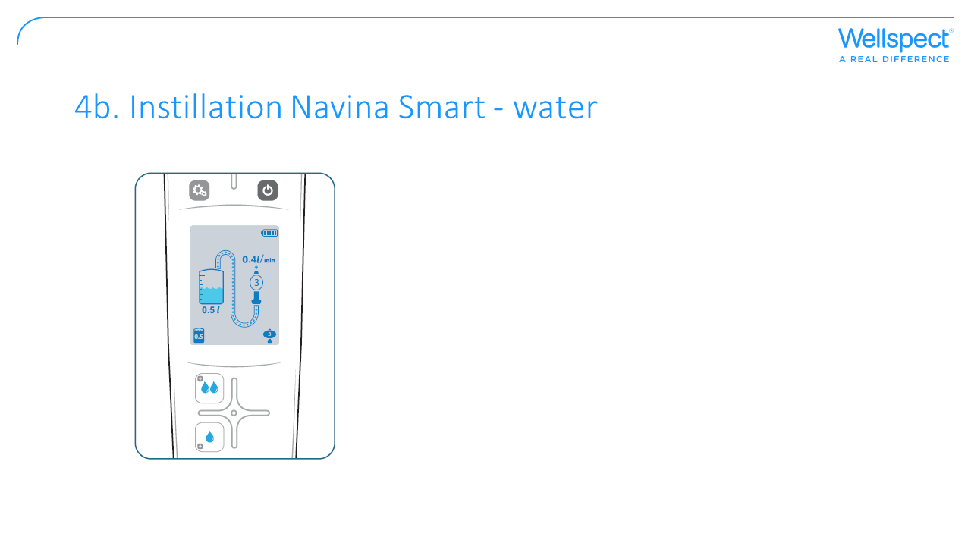
Notes:
Instill water
Children: Monitor the child’s face during instillation, for signs of distress or discomfort. Stop or pause if it is uncomfortable for the child.
Navina Smart
1. Press “instillation of water”-buttons 1 or 2 to instill the preset water volume.
2. Check the display to see the amount of instilled water under the water container symbol and the flow rate over
the catheter symbol.
3. Stop or pause the instillation at any time by releasing the button.
IMPORTANT: Do not turn off the Navina Smart control unit during irrigation. The Navina Smart control unit should not be turned off until all tubes are disconnected.

Slide 40
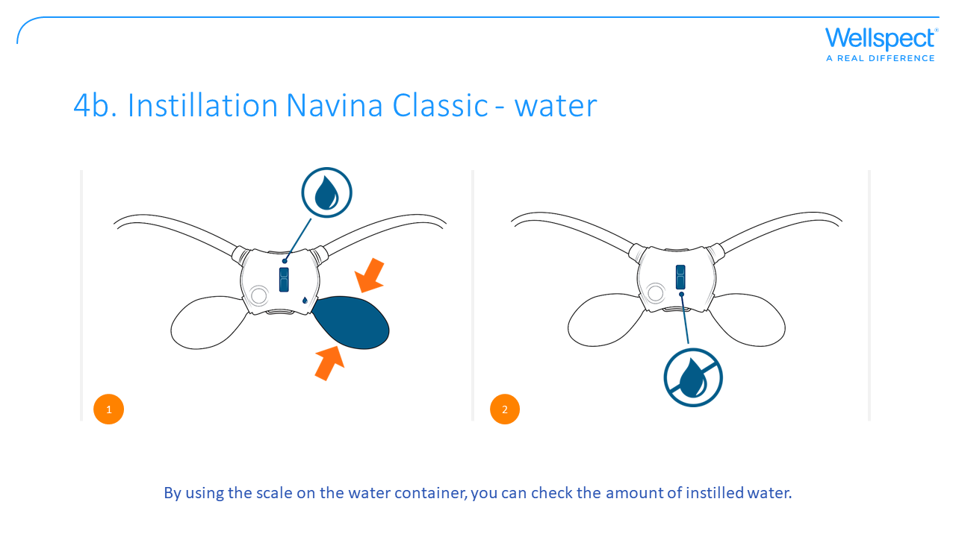
Notes:
Instill water
Children: Monitor the child’s face during instillation, for signs of distress or discomfort. Stop or pause if it is uncomfortable for the child.
Navina Classic
1. Open the water flow. The water flow is open when you can see the water symbol above the blue switch.
2. Use the dark blue pump to instill the volume of water.
3. Stop or pause the instillation at any time by releasing the pump and closing the water flow with the blue switch.
Note: The speed at which water is instilled varies depending on how fast you pump. Pumping with full pump capacity every 5 to 10 seconds gives a flow rate of approximately 300-500 ml/min.

Slide 41
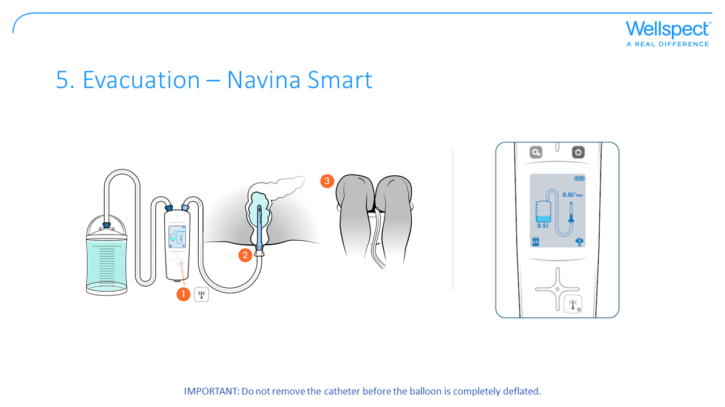
Notes:
When sitting on the toilet, deflate the balloon totally before gently removing the catheter to start evacuation.
If the colon does not start to empty on its own, relax for 10-15 minutes and then try to lean forward, cough, perform abdominal massage or move the upper body to start the emptying process. The evacuation time is individual and can vary from one day to another. Ensure a comfortable position on the toilet (with a footstool if feet do not touch the ground) to promote pelvic floor relaxation.
Remove catheter Navina Smart
1. Press “deflate balloon”-button until the balloon is totally empty.
2. Pull out the catheter gently.
3. Rest the catheter on the inside of the toilet or place it back in the packaging.
IMPORTANT: In case the balloon cannot be deflated, detach the tube either from the catheter side or from the Navina
control unit. This will deflate the balloon immediately.
Remove cone
1. Pull out the cone gently.
2. Rest the cone on the inside of the toilet or place it back in the packaging.

Slide 42
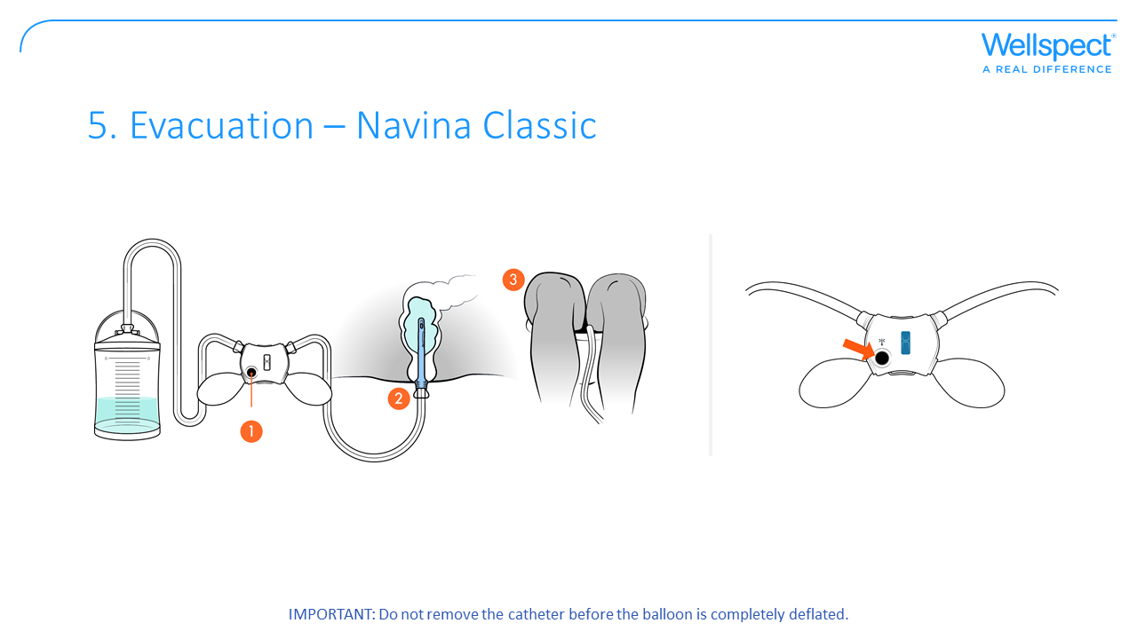
Notes:
When sitting on the toilet, deflate the balloon totally before gently removing the catheter to start evacuation.
If the colon does not start to empty on its own, relax for 10-15 minutes and then try to lean forward, cough, perform abdominal massage or move the upper body to start the emptying process. The evacuation time is individual and can vary from one day to another. Ensure a comfortable position on the toilet (with a footstool if feet do not touch the ground) to promote pelvic floor relaxation.
Remove catheter Navina Classic
1. Press and hold “deflate balloon”-button until the balloon is totally empty (may take 10 seconds).
2. The catheter may slide out by itself. If not, pull out the catheter gently.
3. Rest the catheter on the inside of the toilet or place it back in the packaging.
IMPORTANT: In case the balloon cannot be deflated, detach the tube either from the catheter side or from the Navina
control unit. This will deflate the balloon immediately.
Remove cone
1. Pull out the cone gently.
2. Rest the cone on the inside of the toilet or place it back in the packaging.

Slide 43
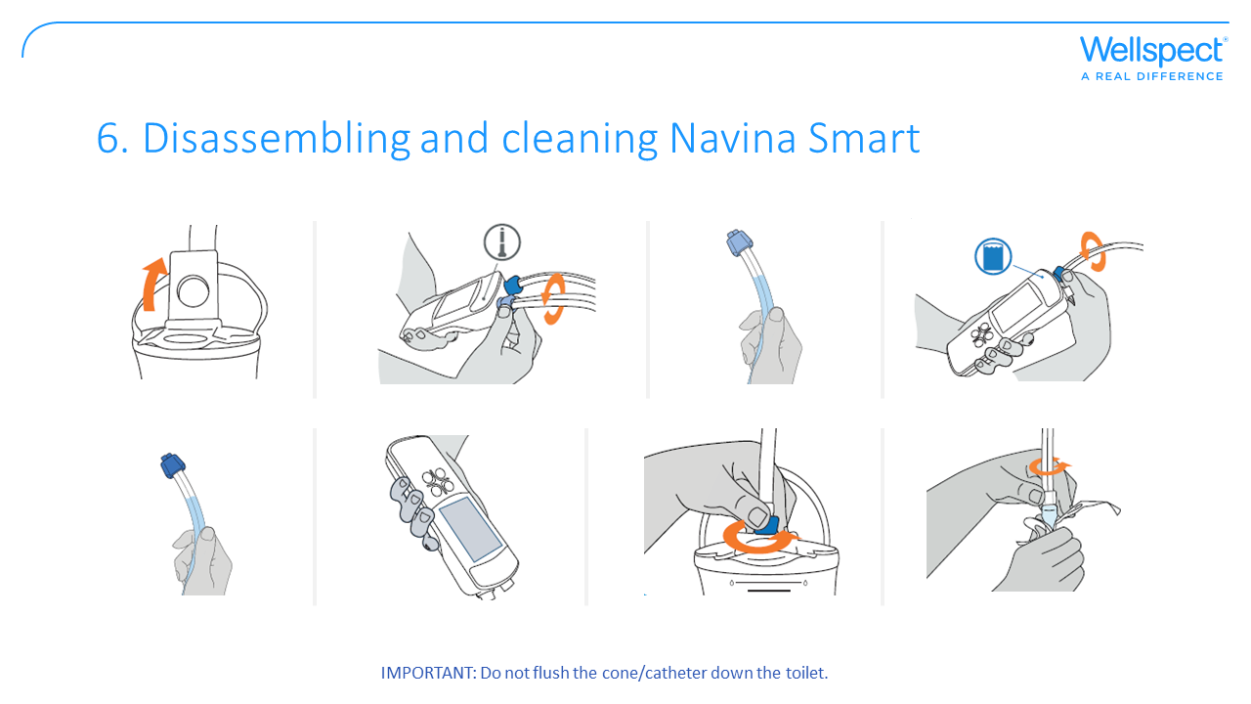
Notes:
It is important to clean the device after each use.
1. Open the lid of the water container to minimize the pressure in the System.
2. Remove the light blue connection from the Navina Smart control unit.
3. Empty the tube of water.
• If the catheter is hanging in the toilet, raise the tube to empty water.
• If the catheter is in the packaging, empty the water through the light blue connector.
4. Remove the tube with the dark blue connection from the Navina Smart control unit.
5. Raise the tube so that the remaining water flows back to the water container.
6. Press and hold the on/off button a few seconds to turn off the Navina Smart control unit.
Note: If the display is in power save mode, press to re-activate the display then press and hold the button once
more for a few seconds to turn off the Navina Smart control unit.
7. Turn the control unit upside down over the toilet or sink to empty any remaining water.
8. Remove the dark blue connection from the water container and empty the remaining water.
9. Hold the tube with the white connection and place the catheter back in its packaging , if not already there, and
disconnect it from the tube.
10. Dispose of the single use catheter and packaging with the household waste.
11. Clean and dry the remaining parts of the System with a cloth and mild soapy water.

Slide 44
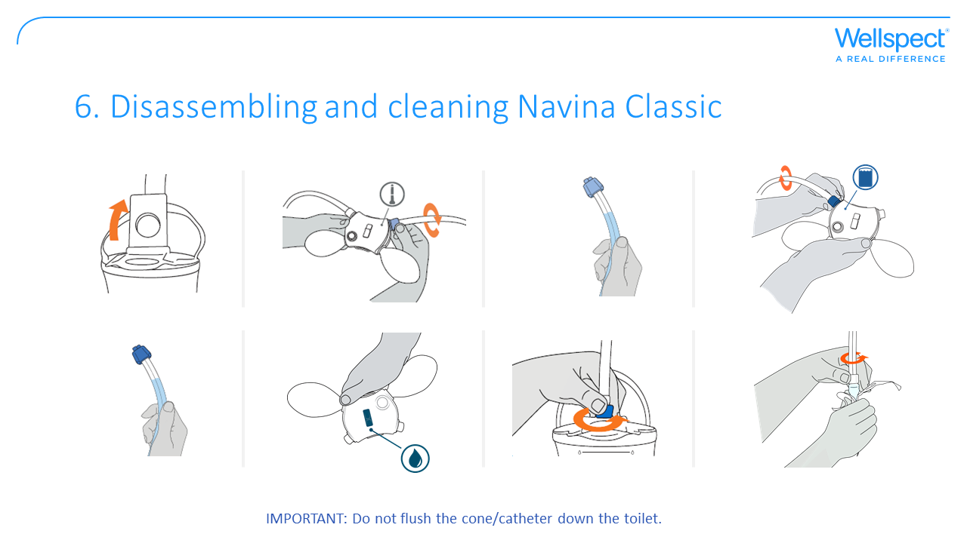
Notes:
It is important to clean the device after each use.
1. Open the lid of the water container to minimize the pressure in the system.
2. Remove the light blue connection from the Navina Classic control unit.
3. Empty the tube of water.
• If the catheter or cone is hanging in the toilet, raise the tube to empty water.
• If the catheter or cone is in the packaging, empty the water through the light blue connector.
4. Remove the tube with the dark blue connection from the Navina Classic control unit.
5. Raise the tube so that the remaining water flows back to the water container.
6. Open the water flow.
7. Turn the unit upside down over the toilet or sink to empty any remaining water.
Note: Pressing the pumps can help making sure the last drops of water come out of the control unit.
8. Remove the dark blue connection from the water container and empty the remaining water.
9. Hold the tube with the white connection and place the catheter or cone back in its packaging, if not already there, and disconnect it from the tube.
10. Dispose of the single use catheter or cone and packaging with the household waste.
11. Clean and dry the remaining parts of the system with a cloth and mild soapy water.

Slide 45
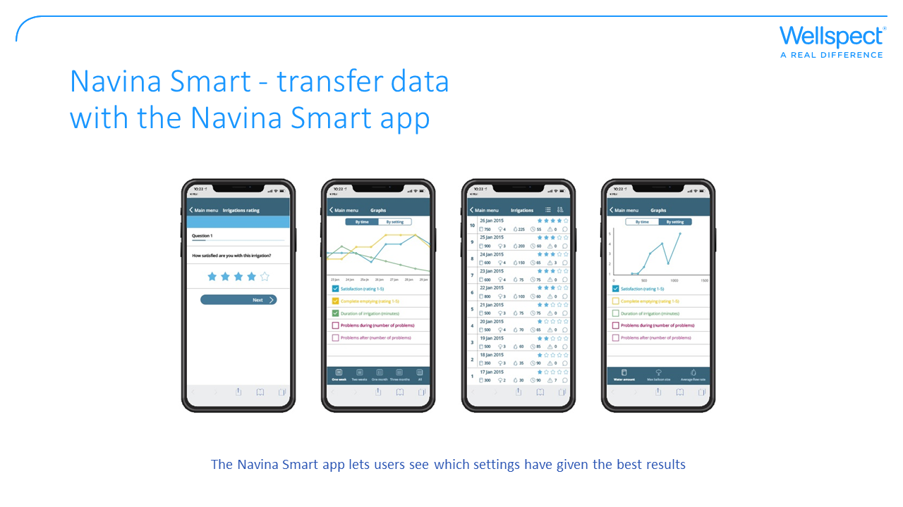
Notes:
1. Press the button to restart the Navina Smart control unit.
2. Activate Bluetooth® on your mobile device.
3. Open the Navina™ Smart app.
4. Enter pin code.
Note: If PIN code is lost, use the last four digits in the serial number found on the screen on your Navina Smart control unit.
IMPORTANT: Due to cybersecurity it is RECOMMENDED to activate the pin code on the Navina Smart Mobile App.
5. Confirm the control unit identity to pair it with the app (first time only).
6. Select synchronize in the app main menu.
7. Rate the latest irrigation uploaded in the app.
Note: When you are on the welcome screen of the Navina Smart control unit, Bluetooth® will be active to allow you to transfer your data to your Navina Smart app. Bluetooth® is only active while you are on the welcome screen. No data can be transferred during irrigation.

Slide 46
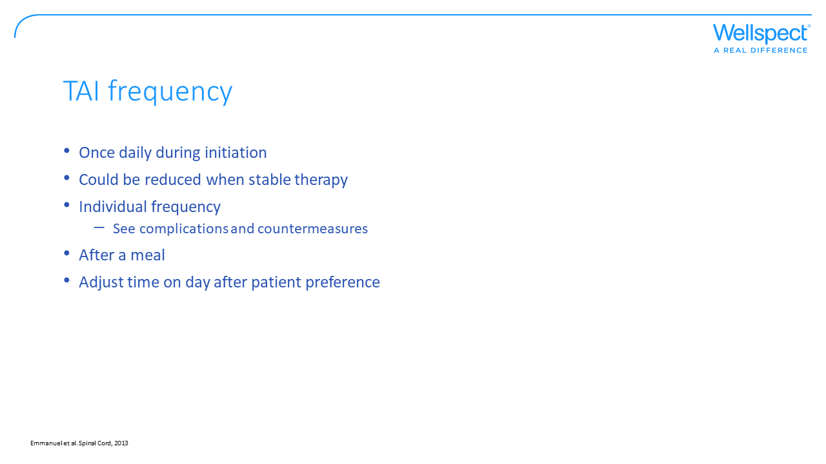
Notes:
The recommendations are that TAI should be performed daily in the beginning, and should then be reduced to alternate days where possible after approximately 10–14 days. Furthermore, maintaining a regular routine of irrigation is beneficial, and undertaking irrigation 20–30min after a meal will take advantage of the gastrocolic response. The time of day should be chosen to fit with the lifestyle of the patient.

Slide 47


Slide 48
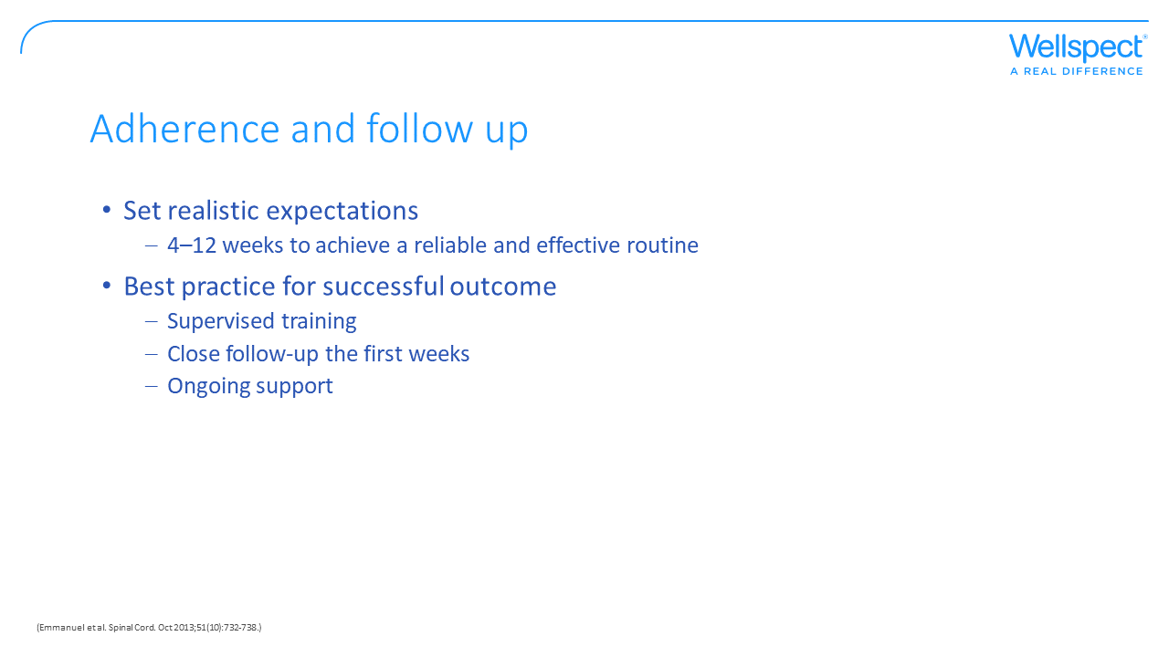
Notes:
In a study on compliance with TAI the main reasons for discontinuing TAI following a successful training session were inefficacy of treatment (41%) , too many constraints (23%) or technical problems (36%) such as:
catheter expulsion
rectal balloon bursting
Instilled water leakage or retention
pain during irrigation
Anal bleeding
Anal fissure

Slide 49
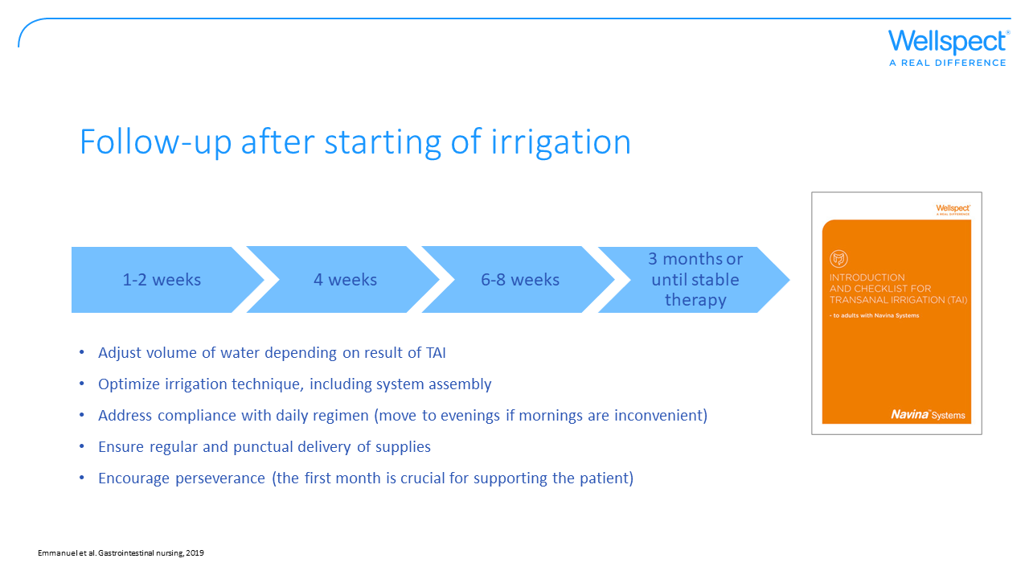

Slide 50
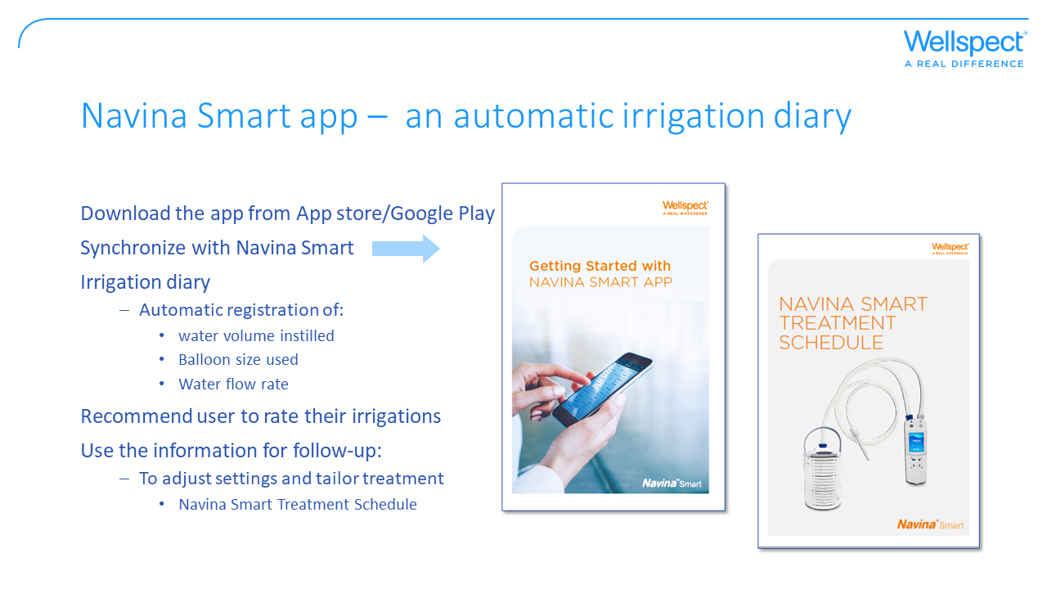
Notes:
Navina Smart app is a useful tool for follow-up on irrigations and helps to optimize and tailor the settings for the users. The Navina Smart app is set up with the Navina Smart control unit, allowing information about water volume used, balloon size, water flow rate and the duration of the irrigation, to automatically be transferred to the app. The combination of treatment data and if the user rates the procedure can be used in discussions to find the right settings for each individual user. During initiation and at follow-up an irrigation diary can be helpful to adjust settings and tailor the treatment. The irrigation data from the app can be viewed in the app or it can be shared through an e-mail in an irrigation report.
Navina Smart Treatment schedule indicates what steps to take when making modifications of the individual user’s irrigation therapy.

Slide 51
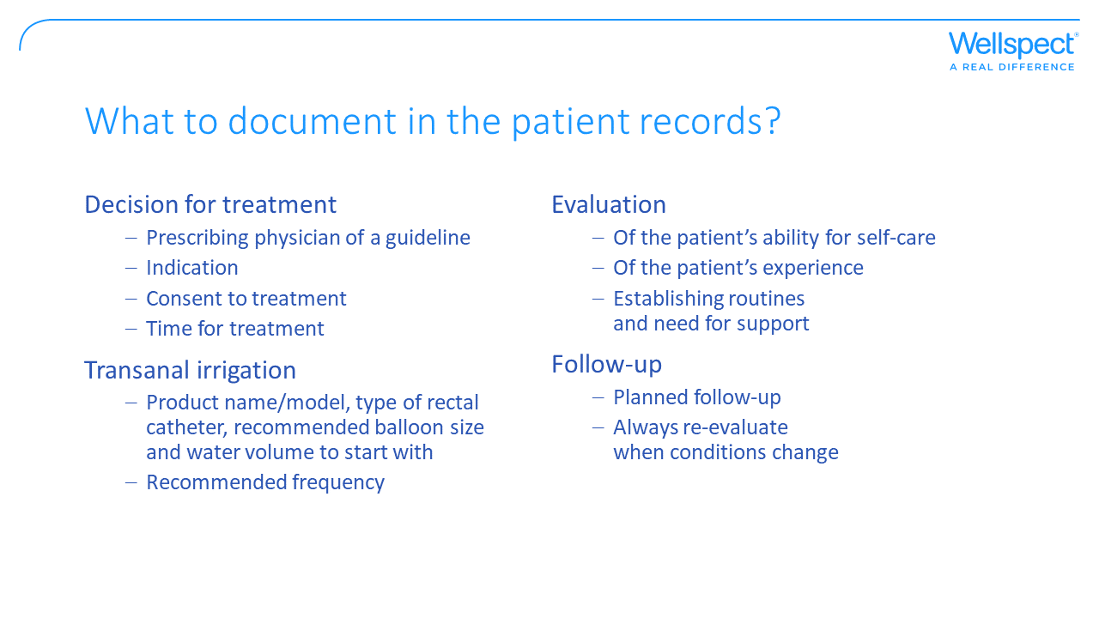
Notes:
There may be local guidelines for prescribing consumables that you need to check.

Slide 52


Slide 53
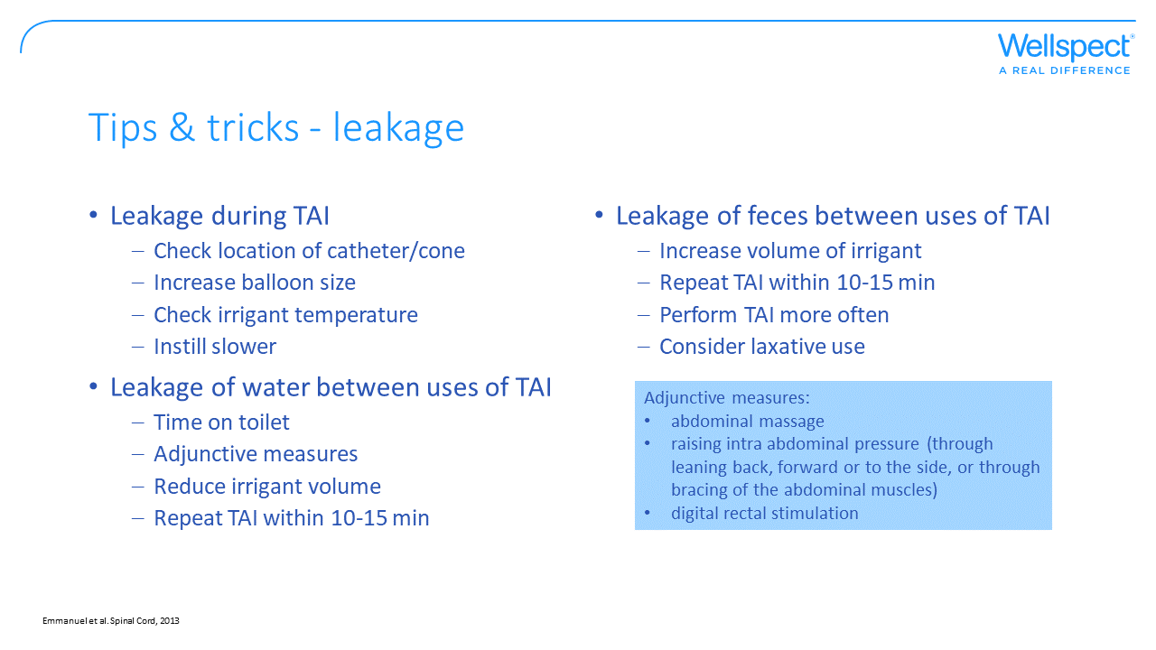
Notes:
Leakage of water (irrigant) during instillation – if there is leakage around the catheter/cone ensure it is properly located, if possible increase balloon size, check water temperature, or instill water more slowly.
Leakage of water between uses of TAI – ensure that the patient allows sufficient time on toilet after removal of the catheter/cone, adjunctive measures to encourage emptying can be used, reduce the volume of water used, divide the irrigation into 2 consecutive episodes with half the amount of water at each session (10-15 minutes between). If not possible to solve the leakage, suggest that the patient can use an anal plug in between TAI sessions.
Leakage of feces between uses of TAI – increase the volume of water with about 100 ml until satisfavtory evacuation is achieved without fecal incontinence, divide the irrigation into 2 consecutive episodes with half the amount of water at each session (10-15 minutes between), increase frequency of TAI and check the laxative use of the patient.

Slide 54
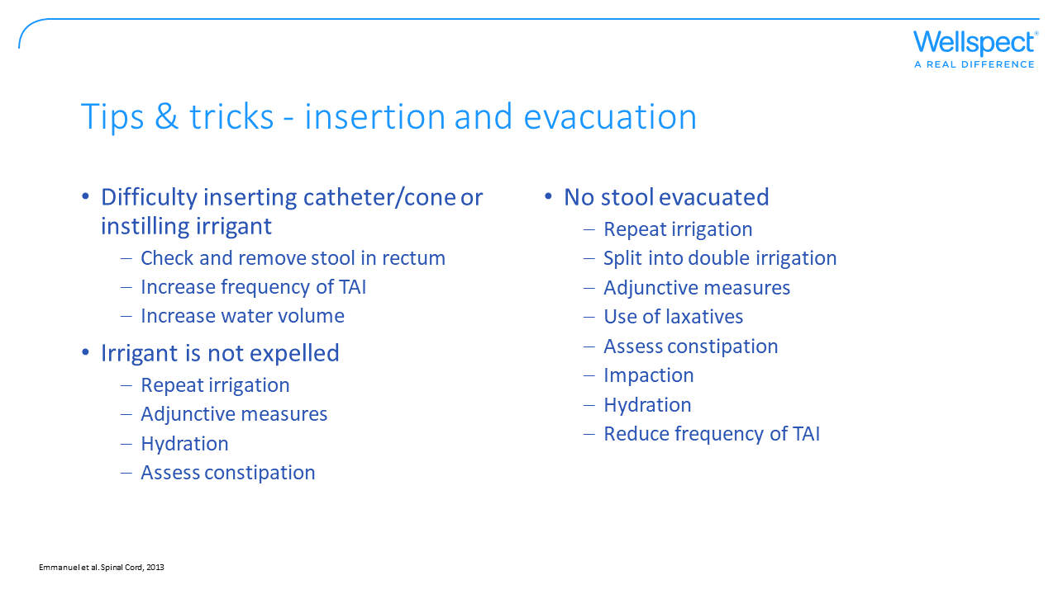
Notes:
Difficulty inserting catheter/cone or instilling irrigant – make a digital rectal check to ensure no stool is present in rectum, increase frequency of TAI or volume of water instilled to ensure evacuation is adequate.
Irrigant is not expelled – if the irrigation fluid/water is not expelled after removal of catheter/cone repeat TAI, use adjunctive measures, make sure the patient is adequately hydrated and assess/treat constipation.
No stool evacuated – repat the irrigation procedure and/or divide the irrigation into 2 consecutive episodes with half the amount of water at each session (10-15 minutes between), use adjunctive measures, consider the use of laxatives, check for constipation and impaction – treat, ensure the patient is well hydrated. If a good result was obtained at last irrigation and this happens regularly consider reducing the frequency of TAI.

Slide 55
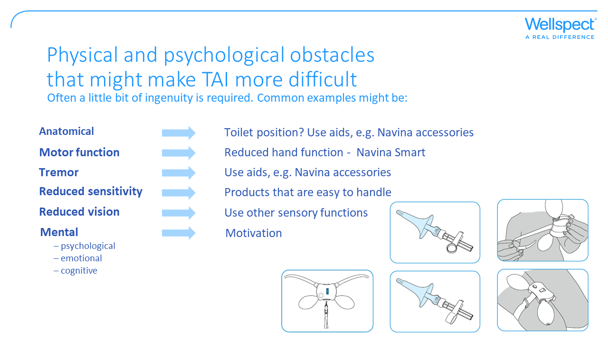
Notes:
Navina accessories:
Navina positioning strap - To facilitate handling, the control unit can be attached to where suitable, for example your thigh, with the help of the positioning strap.
Navina Smart control unit positioning Clip (not used with Navina Classic) -
Navina grip rings - There are two different grip rings to facilitate the handling of the cone. Place one of the rings (vertical or horizontal) on the cone tube, close to the cone connector. Press until it clicks to secure the grip ring in place.
Navina lanyard - The lanyard let´s the control unit hang around your neck.

Slide 56


Slide 57


Slide 58


Slide 59


Slide 60


Slide 61


Slide 62


Slide 63


